Slide 1





NSUF Annual Meeting 2025
Irradiation performance of Uranium Mononitride
Maria Kosmidou, Adrien E. Terricabras, Caitlin A. Kohnert, Joshua T. White, Erofili Kardoulaki
Contributors: Christopher Matthews, Hi T. Vo, Michael W.D. Cooper, A. David R. Andersson, Darrin D. Byler, Materials Science & Technology Division, Los Alamos National Laboratory
Collaborators: Wei-Ying Chen
Nuclear Science and Engineering Division, Argonne National Laboratory
Wednesday, April 16, 2025
LA-UR-25-23399

Slide 2
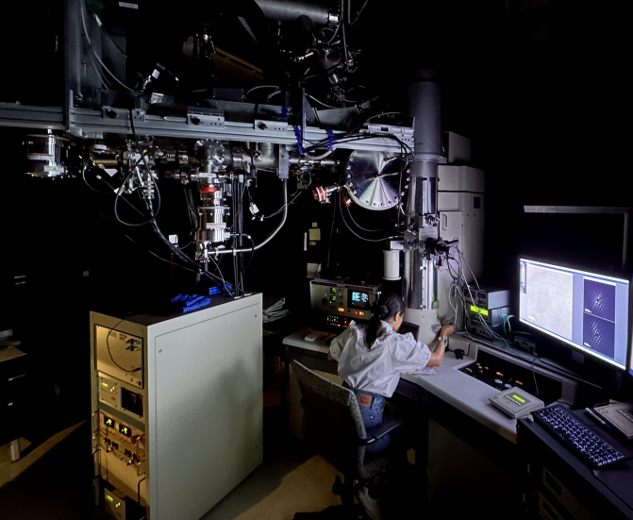
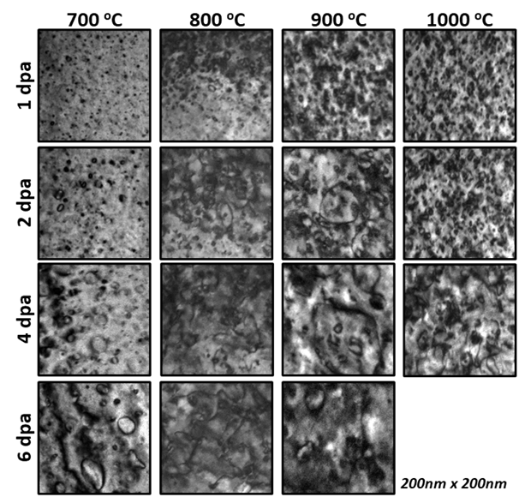
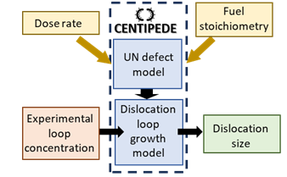
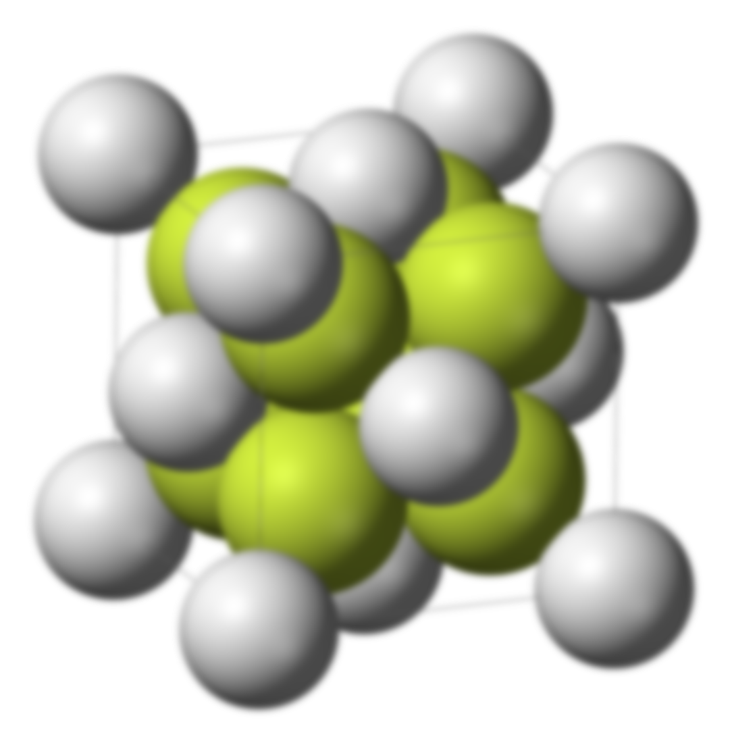
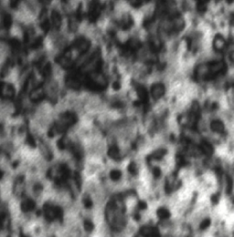
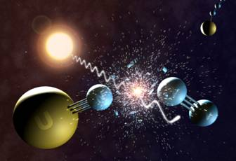
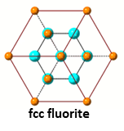
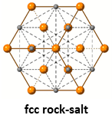
Outline
NSUF: Argonne National Laboratory
Post-processing analysis
Defect growth model
In-situ IR TEM tests
M-X type fuels
Fuel Insights
UN vs UO₂
Previous studies
Loop types
Loops near the GBs

Slide 3
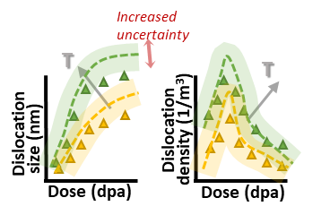
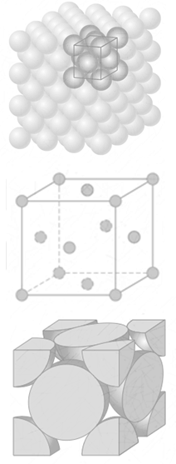

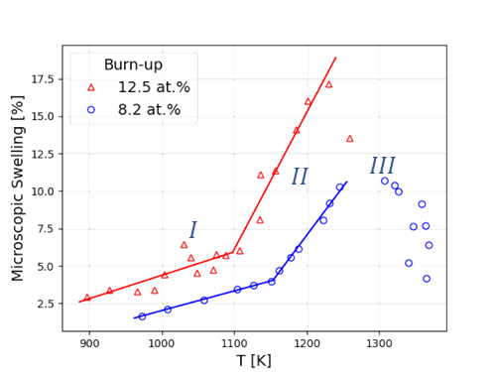

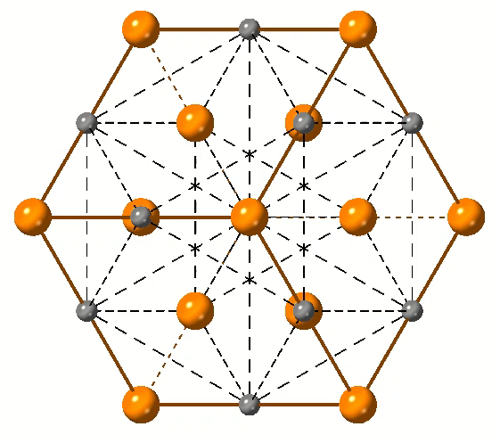
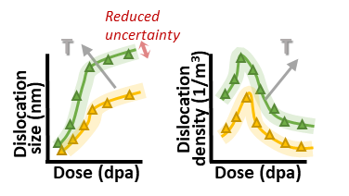
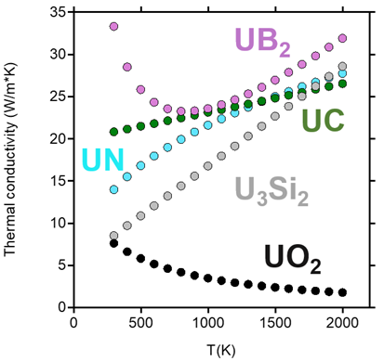

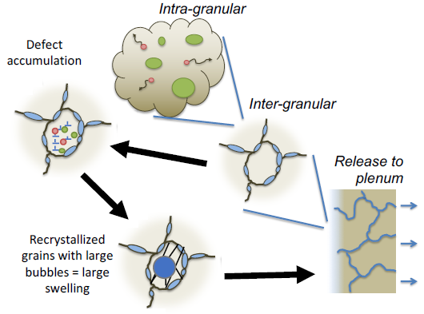
UN defect growth model – Cluster dynamics code CENTIPEDE
Outline
UN as advanced nuclear fuel
Uranium Mononitride: MX-type nuclear fuel
Modelling validation & calibration
Sensitivity analysis of diffusion coefficients
Fission swelling
Thermal conductivity
DIMENSIONAL INSTABILITY → POINT DEFECT SINKS
Density
MICROSTRUCTURE
COMPOSITION
Dislocations
(loops, lines)
Grain boundaries
Impurities (thermomechanical processing)
Gas bubbles (at certain sinks: dislocations, GB, impurities)
Cavities (represent swelling)
Advanced Nuclear Fuel:
Generation IV reactors
  BREST-OD-300
  SVBR-75/100
  BN-800
Thermal propulsion rockets
Li-cooled spaced power reactors
Notes:
UO2: Is poor conductor with higher thermal gradients (center T 2400oC compared to U- N and C that reach 1400oC)
Irradiation Stability, Chemical compatibility with most of the cladding materials, Longer fuel cycle time owing to neutronic behavior of UN in the core (UO2 18months vs 25 for UN for 50GWd/tU) → Leads to fewer shut-downs for reloading
Swelling is caused by bubbles of fission gas (Xe, Kr), whose evolution is governed by diffusion mechanisms, fuel microstructure,
and irradiation. Breakaway swelling refers to faster bubble growth and increased swelling rate due to irradiation induced changes to the fuel microstructure
Fission gas bubbles that sit on dislocations drive this phenomenon – Fission gas swelling drives breakaway swelling – it is important to develop models that predict dislocation growth characteristics (they also describe fission gas swelling/breakaway swelling) – rely on accurate diffusion coefficients -> those coefficients also dictate dislocation growth so need to validate those
“Breakaway swelling” in UN:
Sudden change in rate of swelling once a threshold temperature is reached (region I $→$ II)
As burn-up increases the threshold temperature lowers

Slide 4
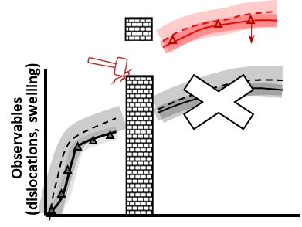




Outline
UN as advanced nuclear fuel
UN defect growth model – Cluster dynamics code CENTIPEDE
Breakaway swelling – BISON fuel performance simulation
Differences between ion- and reactor-based irradiations
Test reactor data
CENTIPEDE
diffusion coefficients: D_{U}, D_{N} , D_{xe}
dislocation size and density:$𝒹,ϱ$
Direct extrapolation
Modelling validation & calibration
Sensitivity analysis of diffusion coefficients
BISON
bubble concentration and size
$$swelling:\frac{ΔV}{V_{o}}\left(T, burnup\right)$$
Notes:
Ion beam is not representative of in reactor conditions –
Utilize controlled experimental parameters to validate the model (Centipede)
Apply established mechanistic parameters into paired model (Bison – Centipede) in order to predict breakaway swelling from radiation damage in-reactor
Reduce uncertainty in-reactor conditions through machine learning
but we validate the same modelling parameters that apply in fuel performance application -> that is why modelling is important. Fission gas swelling drives breakaway swelling – it is important to develop models that predict dislocation growth characteristics (they also describe fission gas swelling/breakaway swelling) – rely on accurate diffusion coefficients -> those coefficients also dictate dislocation growth so need to validate those
Predict breakaway swelling from radiation damage in-reactor & reduce uncertainty in-reactor conditions through machine learning

Slide 5
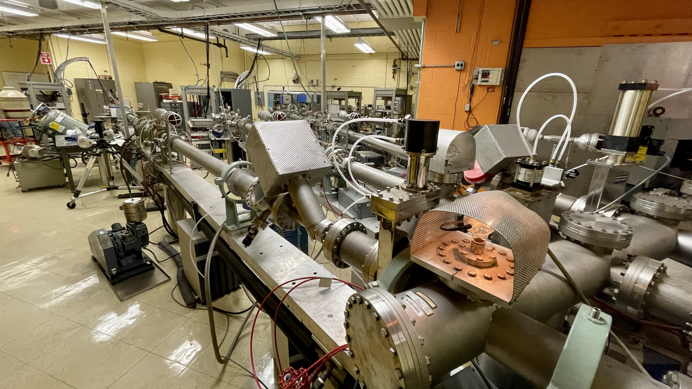


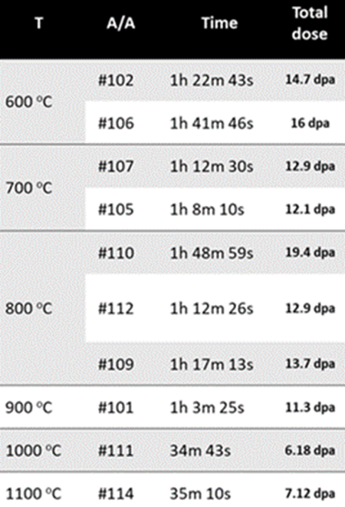
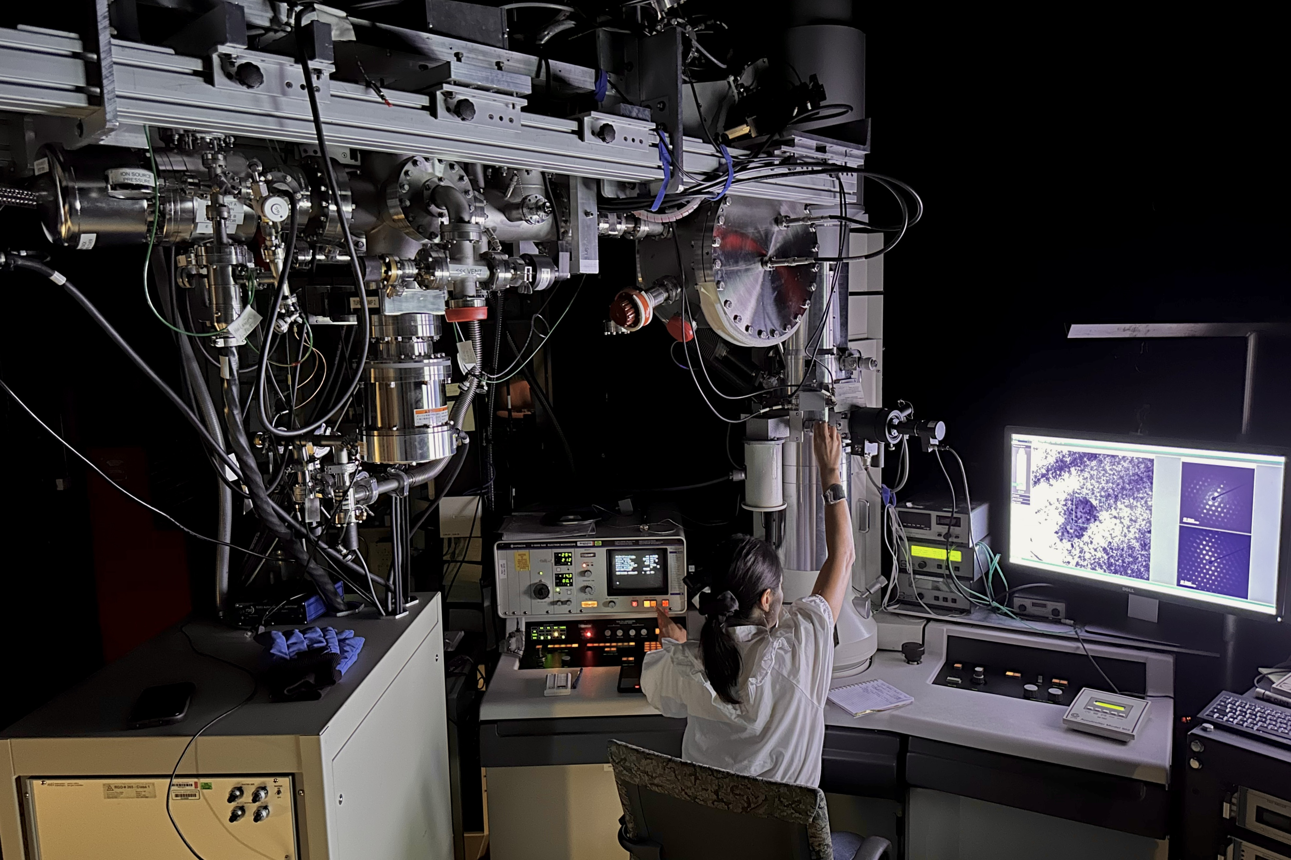
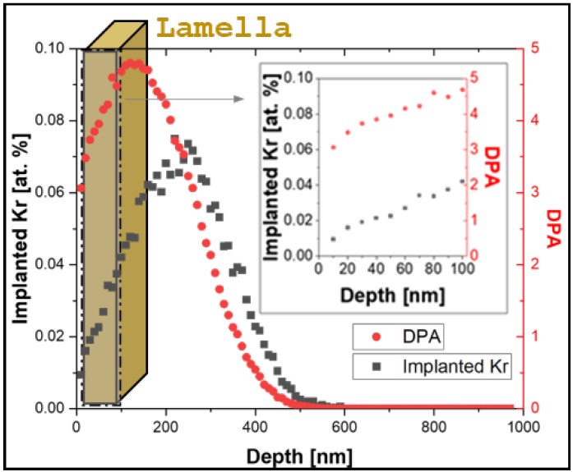
Outline
UN as advanced nuclear fuel
RTE proposal–IVEM facility
Intermediate Voltage Electron Microscope facility
Rapid Turnaround Experiment proposal:
#1868: Elucidating the Effect of Radiation-Induced Defect Accumulation on Swelling in UN using in-situ TEM Irradiation

Slide 6
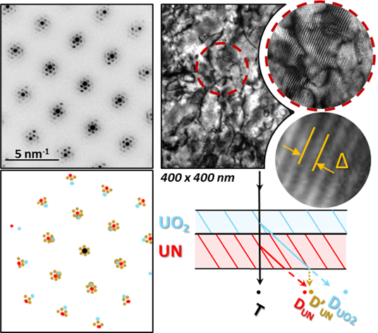
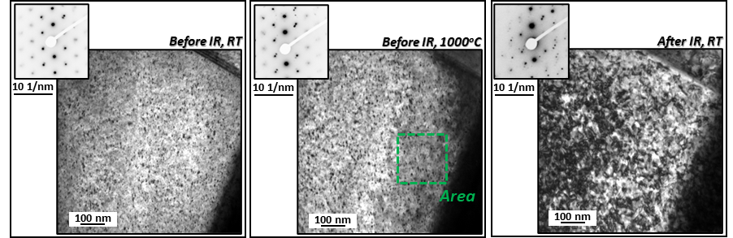
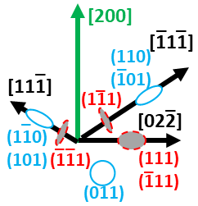
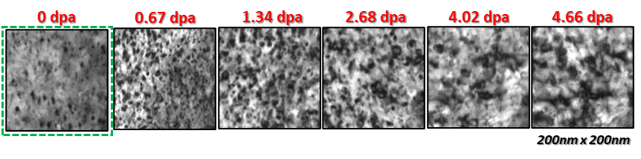
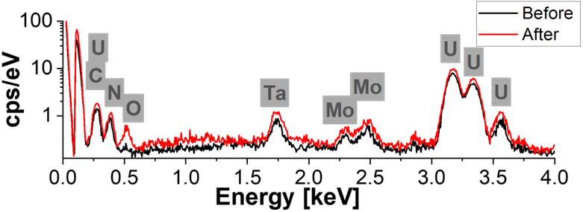
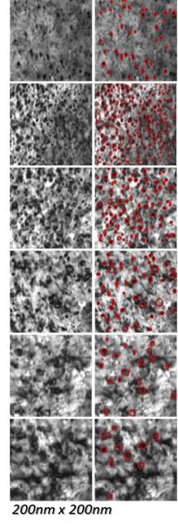
Outline
UN as advanced nuclear fuel
RTE proposal–IVEM facility
In-situ IR TEM tests
Temperature: 1000 ºC
Duration: 34’ 43’’
Total dose: 4.66 dpa
2-beam kinematical condition → zone axis [110], g 200
EDS elemental analysis at room temperature before and after ion irradiation
Oxygen signal is apparent after the irradiation test at 1000 ºC
Kosmidou et.al., Temperature dependency of dislocation evolution in Kr-irradiated Uranium Mononitride (UN) through in-situ TEM observation and modeling, Acta Materialia, 2025

Slide 7
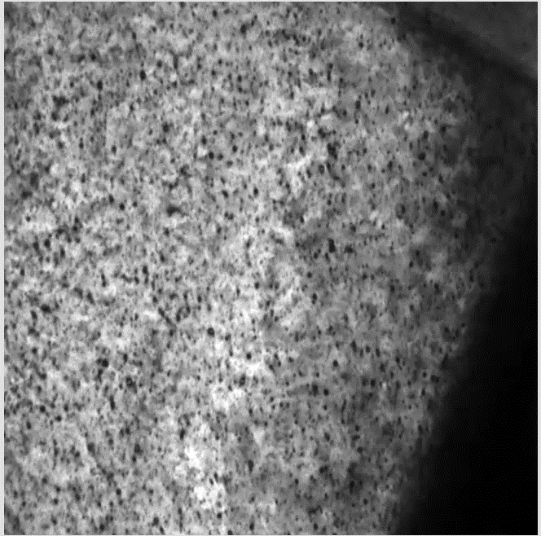
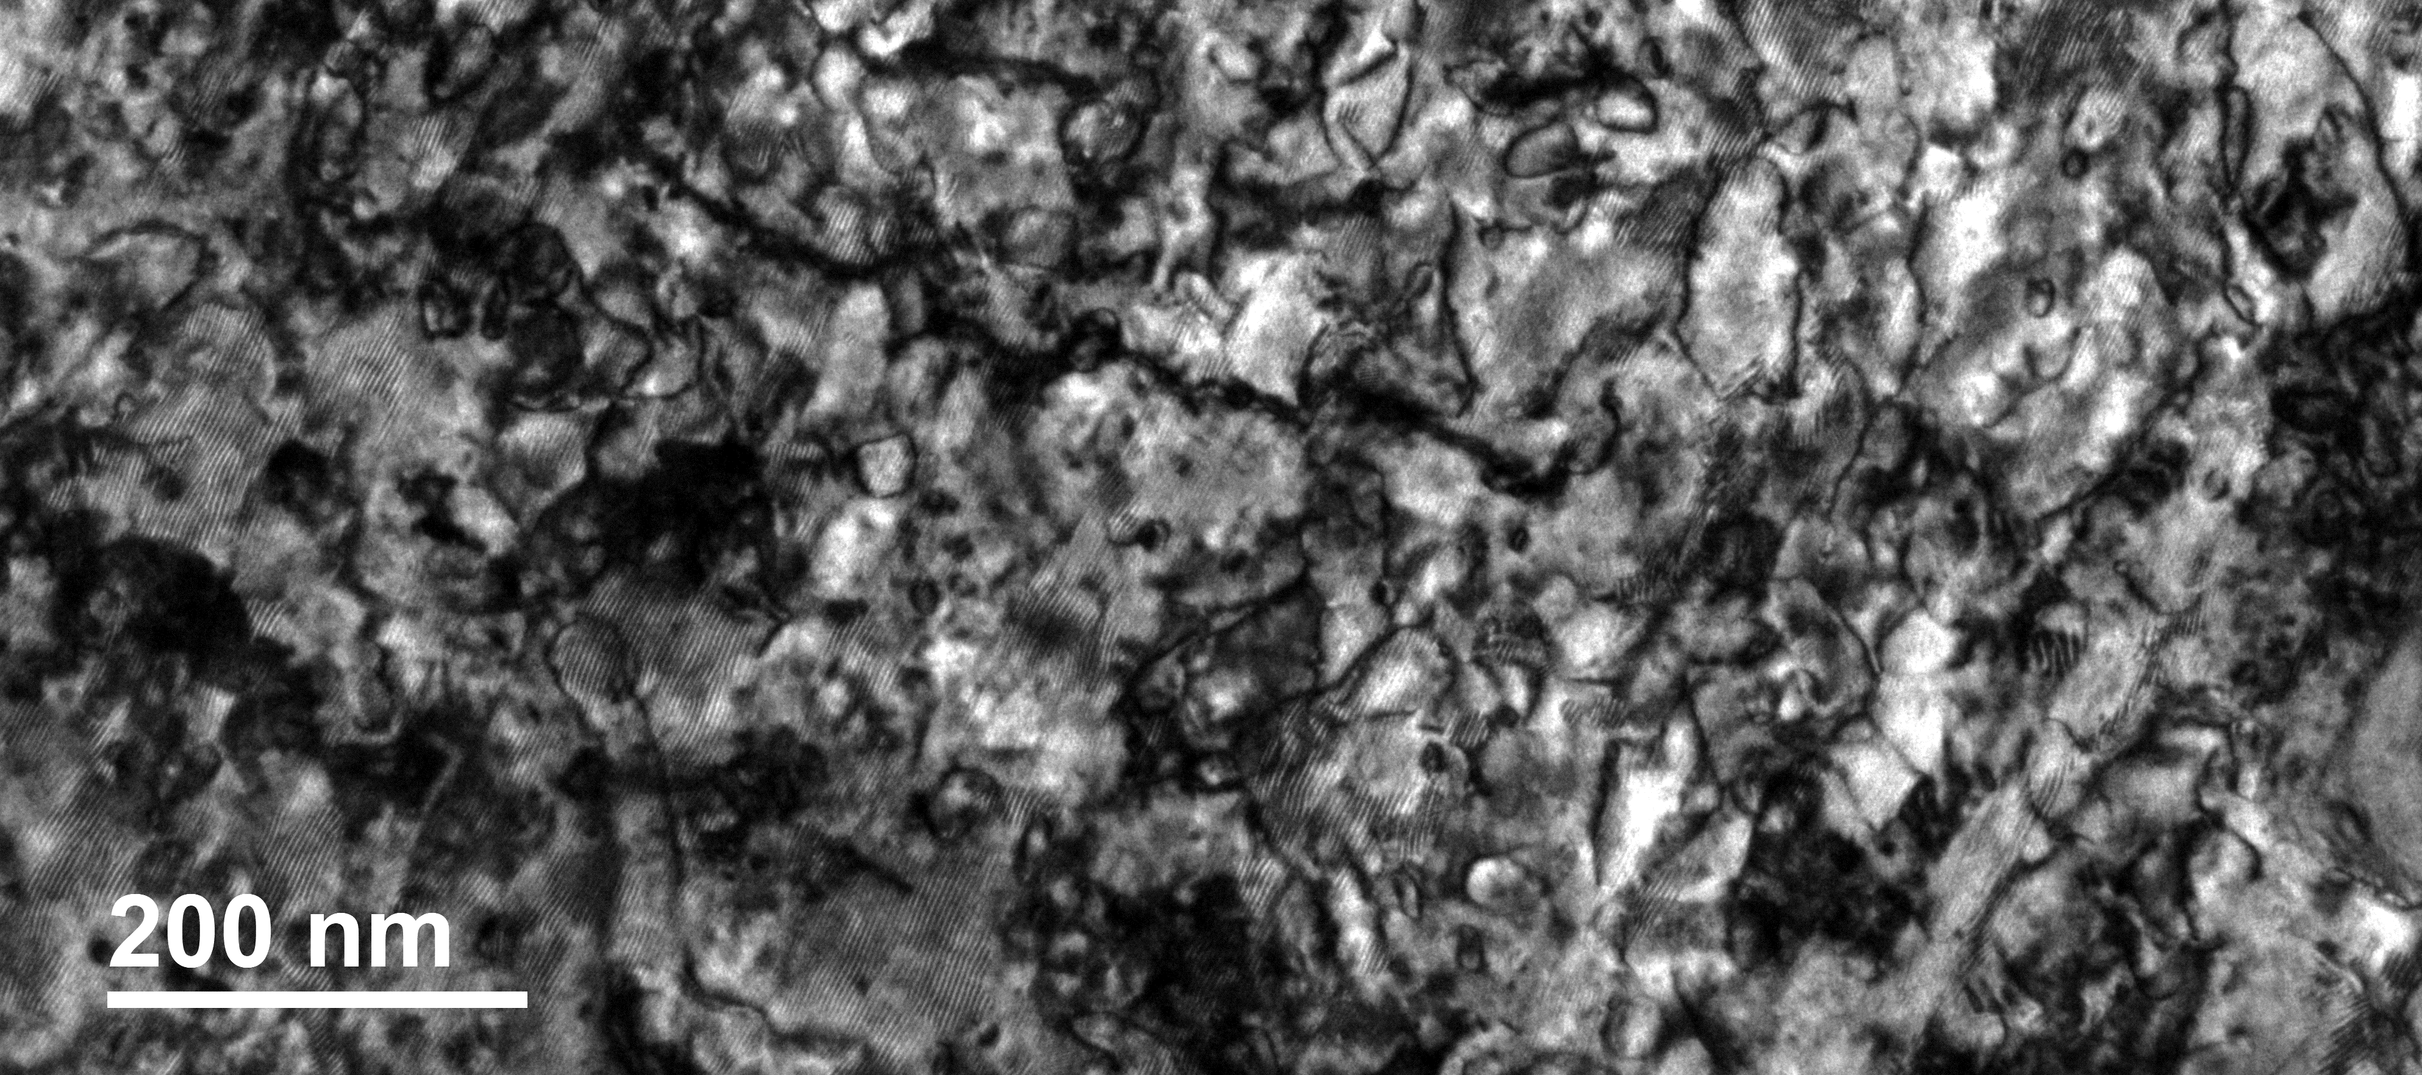
Outline
UN as advanced nuclear fuel
RTE proposal–IVEM facility
In-situ IR TEM tests
Temperature: 1000 ºC
Duration: 34’ 43’’
Total dose: 4.66 dpa
Dislocation evolution:
Point defect formation – depletion
Dislocation loop nucleation
Dislocation loop growth
Co-existence of dislocation loops and lines
Tangled network
Area: 785 x 785 nm

Slide 8
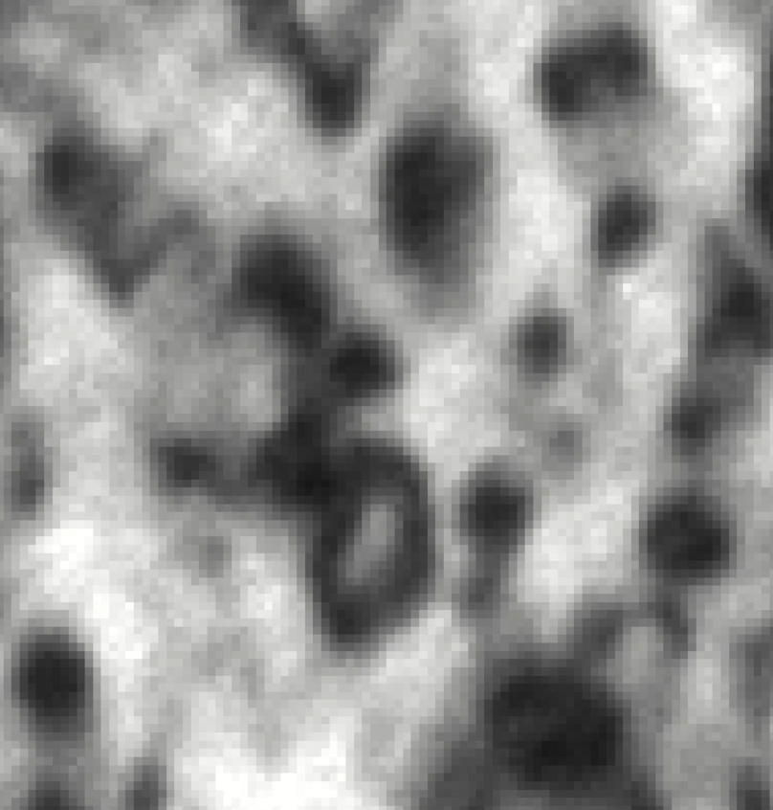
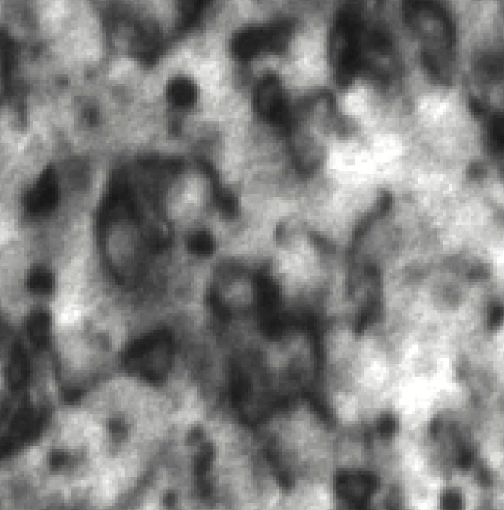
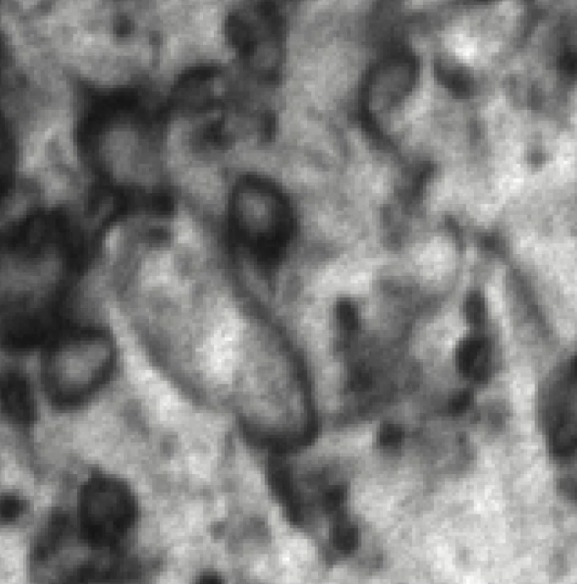
Outline
UN as advanced nuclear fuel
RTE proposal–IVEM facility
In-situ IR TEM tests
Coalescing events
Surface sink
Loop – line interaction

Slide 9
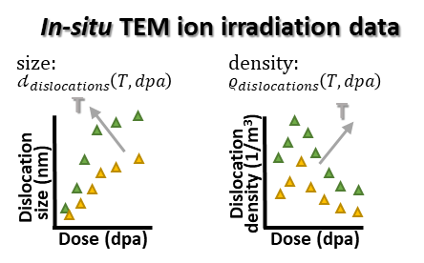
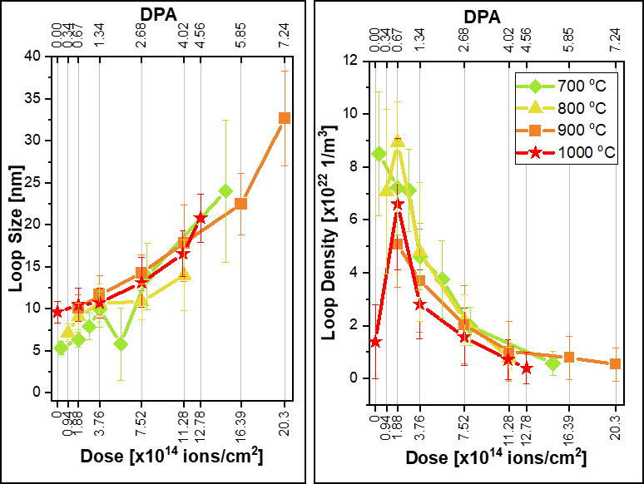

Outline
UN as advanced nuclear fuel
RTE proposal–IVEM facility
In-situ IR TEM tests
Experimental Integration Defect growth model
Kosmidou et.al., Temperature dependency of dislocation evolution in Kr-irradiated Uranium Mononitride (UN) through in-situ TEM observation and modeling, Acta Materialia, 2025
Notes:
The loop size: rapid rise of the loop size as the dose increases. However, due to the broad standard deviation across all the tests and their overlapping nature, there is no significant evidence supporting temperature dependency in loop size. Loop density: a linear trend across all temperatures with lower loop density values observed at higher temperatures.
The rise of loop density at the early stages of ion dose shows their nucleation and growth, reaching the saturation peak for all temperatures below 1 dpa.

Slide 10
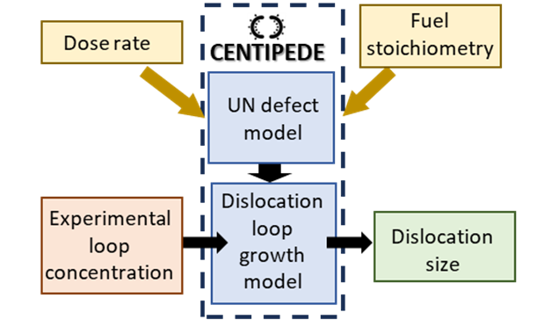
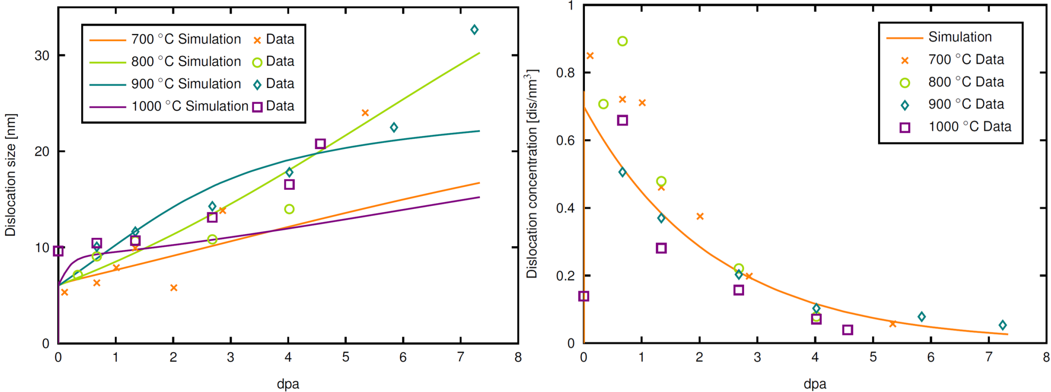
Outline
UN as advanced nuclear fuel
RTE proposal–IVEM facility
In-situ IR TEM tests
Experimental Integration Defect growth model
UN defect growth model – Cluster dynamics code CENTIPEDE
Kosmidou et.al., Temperature dependency of dislocation evolution in Kr-irradiated Uranium Mononitride (UN) through in-situ TEM observation and modeling, Acta Materialia, 2025
Notes:
Critical uncertainties
Model formulation: Nucleation and growth by interstitial absorption
Defect energies and diffusivities
Model parameters → Sink bias
The mechanistic model in Centipede can be used to apply the cluster dynamics dislocation model despite the higher dose rate than in-reactor conditions (3 orders of magnitude higher with ions).
In place of a dislocation coalescence model, the experimental concentrations were utilized, with the dislocation sizes solved via the cluster dynamics model.
The comparison between data and the model were reasonable.

Slide 11
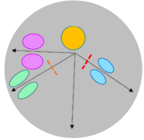
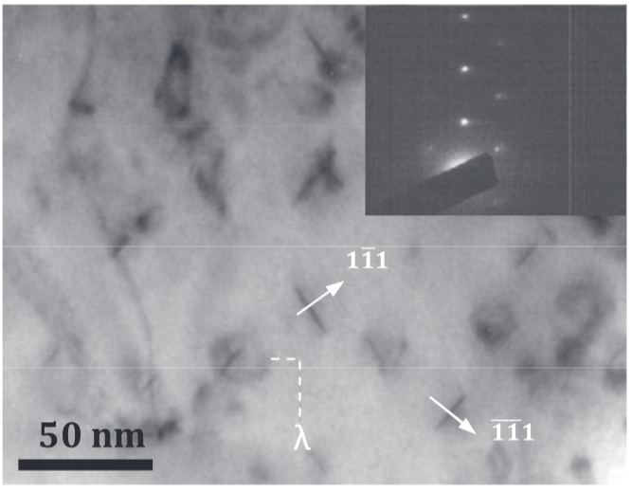
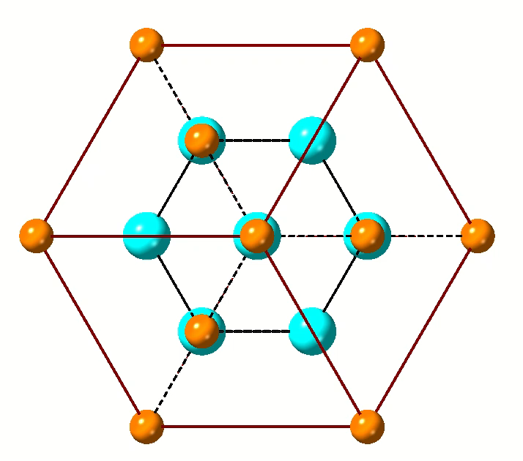
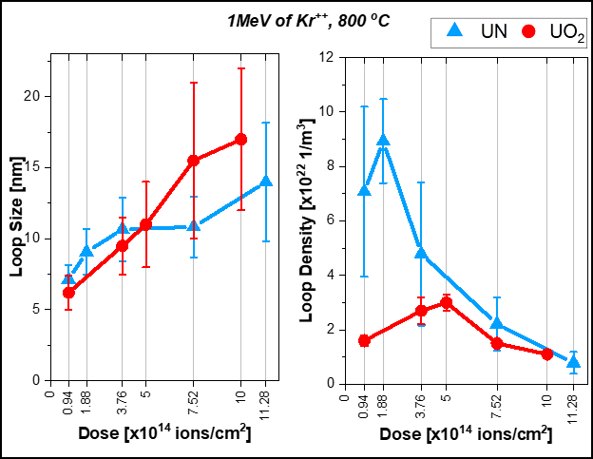
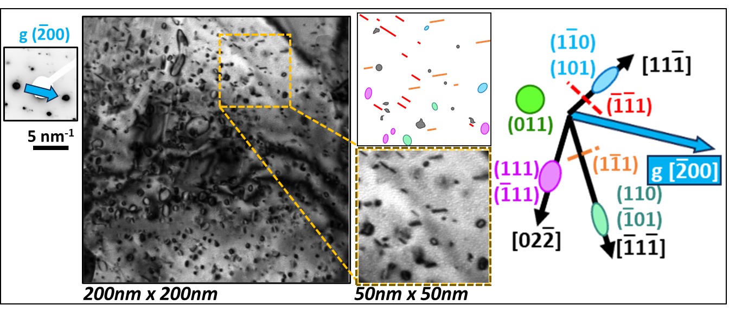
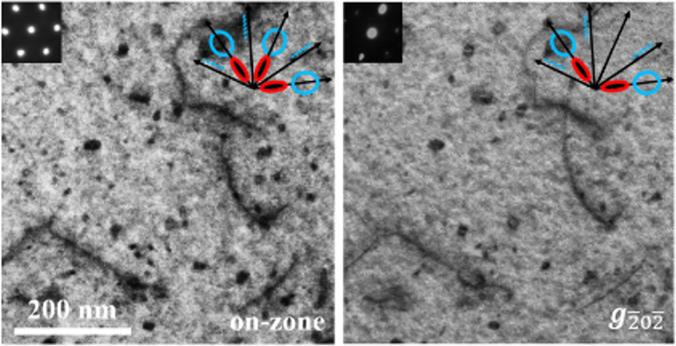
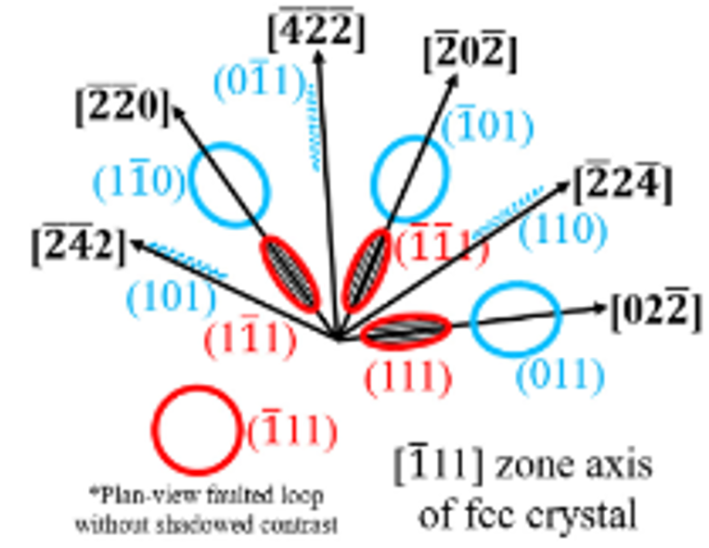
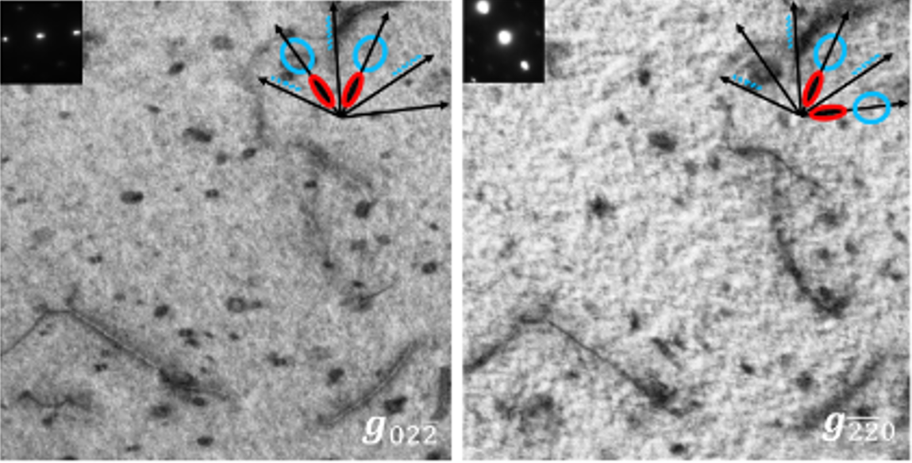
Outline
UN as advanced nuclear fuel
RTE proposal–IVEM facility
In-situ IR TEM tests
Experimental Integration Defect growth model
Fuel insights
Comparative Analysis: UN vs UO₂
Dislocation loop types in fcc
Defect evolution in UN compared to UO₂:
↓ loop size and ↓ growth rate
↑ loop density with lower critical dose for loop saturation
CeO₂ at 800 ºC
IR: 1 MeV of Kr²⁺
5E14 ions/cm²
Identical IR conditions:
1MeV Kr²⁺
800 ºC
Flux: 7.70E11 for UO₂
6.25E11 for UN
Faulted dislocation loops(≤20nm size) have been observed in CeO₂ (IR: 1MeV Kr²⁺, 800 ºC) and in ThO₂ (IR: 1MeV Kr²⁺, 600 ºC)
Not observed experimentally in U-based alloy with fluorite structure (e.g. UO₂)
*
fcc fluorite
*W. Chen et.al., Characterization of dislocation loops in CeO₂ irradiated with high energy Kr and Xe, Phil. Mag., 2013
UN at 710 ºC
IR: 2 MeV of H⁺
8E18 ions/cm²
Formation of perfect loops in UN (IR: 1MeV Kr²⁺, 600-1000 ºC)
Faulted dislocation loops (6-10nm) have been observed at 1100 ºC
fcc rock-salt
UN at 1100 ºC
IR: 1 MeV of Kr⁺⁺
1.32E15 ions/cm²
*He et.al., In situ TEM observation of dislocation evolution in Kr-irradiated UO₂ single crystal, JNM, 2013
*P. Xiu et.al., Dislocation Loops in Proton Irradiated U-N-O System, JNM, 2021
Kosmidou et.al., Temperature dependency of dislocation evolution in Kr-irradiated Uranium Mononitride (UN) through in-situ TEM observation and modeling, Acta Materialia, 2025
Notes:
Loop size: Rapid rise of loop size as a function of dpa. However, due to the broad st. dev across all tests and their overlapping nature, there’s no significant evidence supporting T dependency in loop size.
Loop density: Linear trend across all T with lower loop density values observed at higher T.

Slide 12
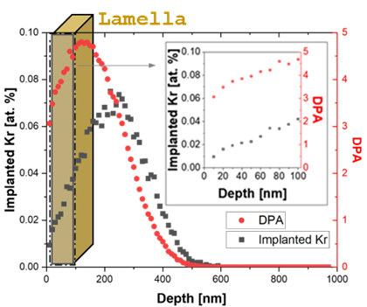
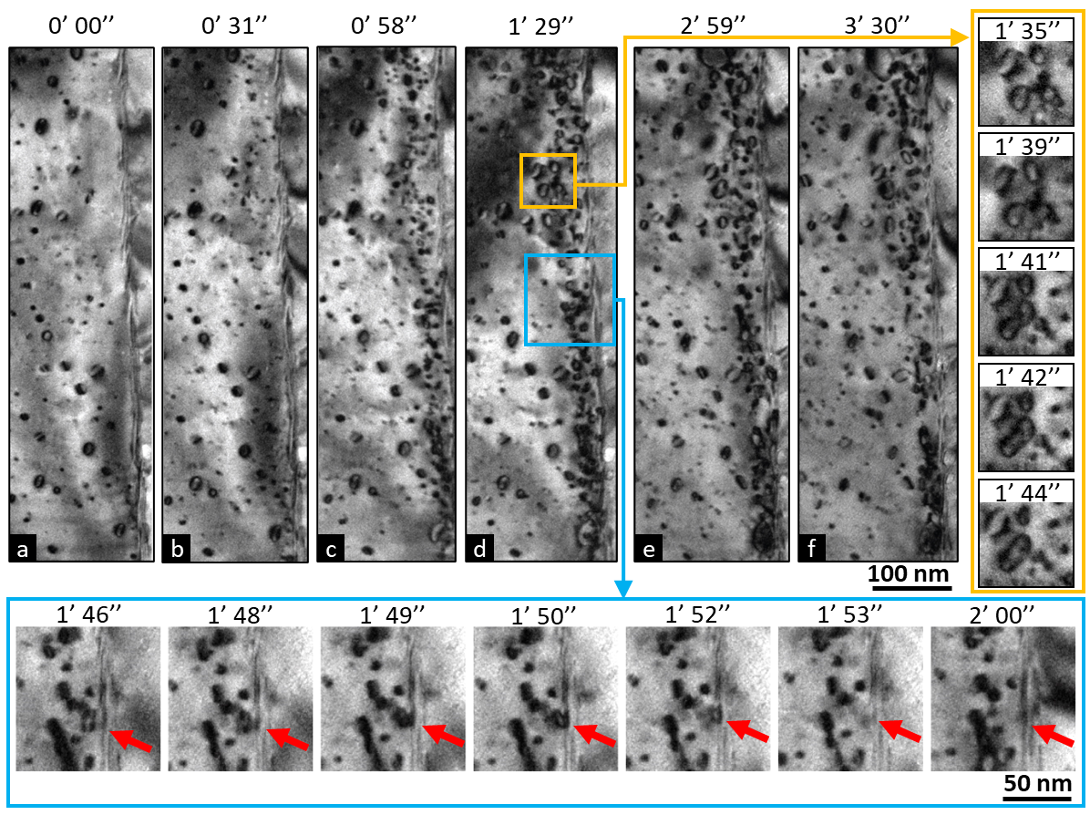
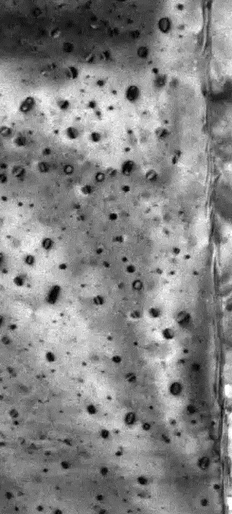
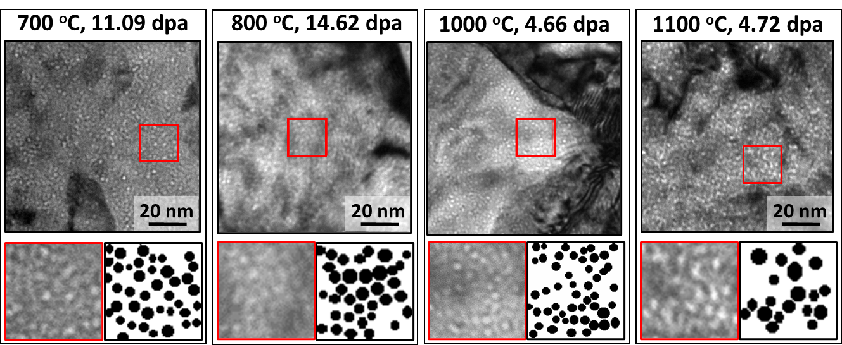
Outline
UN as advanced nuclear fuel
RTE proposal–IVEM facility
In-situ IR TEM tests
Experimental Integration Defect growth model
Fuel insights
Cavity formation
Dislocation loop formation near GB
Intragranular loops (7-14nm) were observed prior to the irradiation test at 1100 ºC
Thermally activated diffusion of point defects from Ga ion impingement
Nanoscale radiation-induced loops preferentially nucleate and grow within a 10 nm width-zone area from the grain boundary. Loop coalescing events are mostly apparent to the left side of the zone and small size near the GB migrate to the sink.
TEM-BF micrographs oriented far from Bragg conditions (under-focus: 1.2 µm of negative defocus) showing the presence small intragranular cavities in UN irradiated at 700, 800, 1000, and 1100 ºC
Kosmidou et.al., Temperature dependency of dislocation evolution in Kr-irradiated Uranium Mononitride (UN) through in-situ TEM observation and modeling, Acta Materialia, 2025

Slide 13
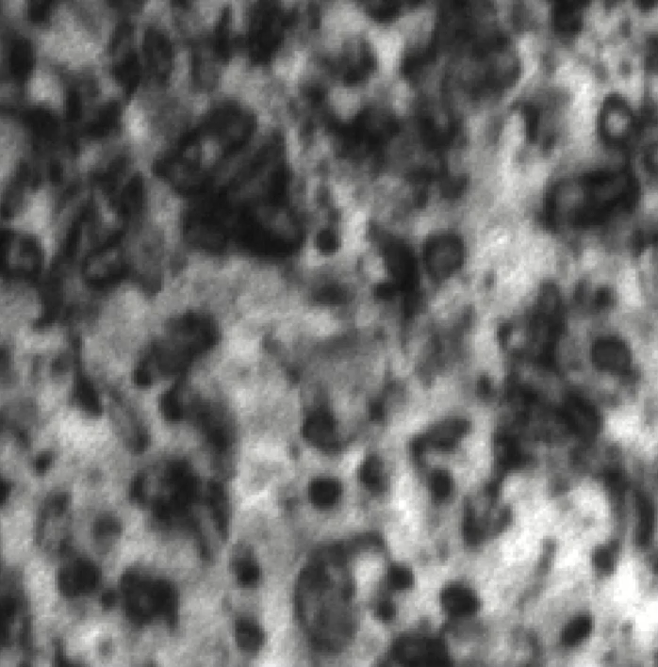
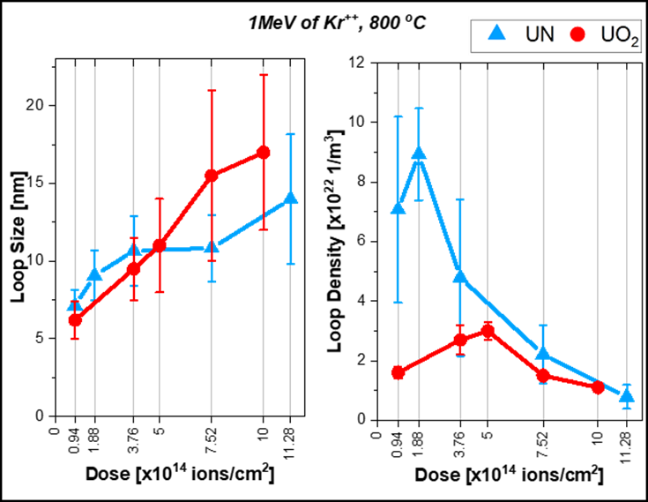
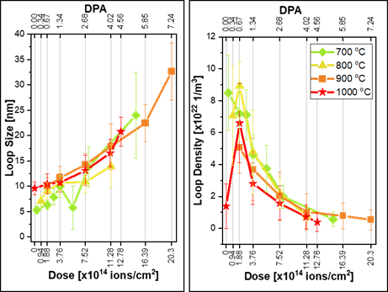



Outline
UN as advanced nuclear fuel
RTE proposal–IVEM facility
In-situ IR TEM tests
Experimental Integration Defect growth model
Fuel insights
Summary
In-situ TEM tests
Defect growth model
UN vs UO₂
Evolution of loop size and density as a function of dpa for 700,800,900,1000 ºC
Targeted irradiation tests allow direct validation of dislocation and fission gas behavior predicted by mechanistic swelling model
Comparative analysis with UO₂: ↓ loop size and ↑ loop density
Perfect - faulted loops
Cavity formation
Loops near GB
Edge-on faulted loops we observed only at 1100 ºC.
No great change in cavity size at different temperatures and doses.
Intragranular dislocation loops are formed near the GB at 1100 ºC (coalesce and migration of loops).

