Slide 1
Investigation of Degradation Mechanisms of Cr-coated Zirconium Alloy Cladding in Reactivity-Initiated Accident (RIA)
Dr. Woo Hyun Jung
Assistant Scientist, University of Wisconsin-Madison
Apr. 16, 2025

Slide 2
Project Team
University of Wisconsin, Madison (UW, Lead organization)
  Dr. WooHyun Jung (Lead PI)
  Dr. Kumar Sridharan (Co-PI)
  Tyler Dabney (graduate student)
POSTECH
  Dr. Hwasung Yeom (Co-PI)
University of Illinois, Urbana-Champaign (UIUC)
  Dr. Brent Heuser
Nuclear Regulatory Commission (U.S. NRC)
  Ms. Michelle Bales
NSUF Technical Lead (INL)
  Dr. David Kamerman

Slide 3
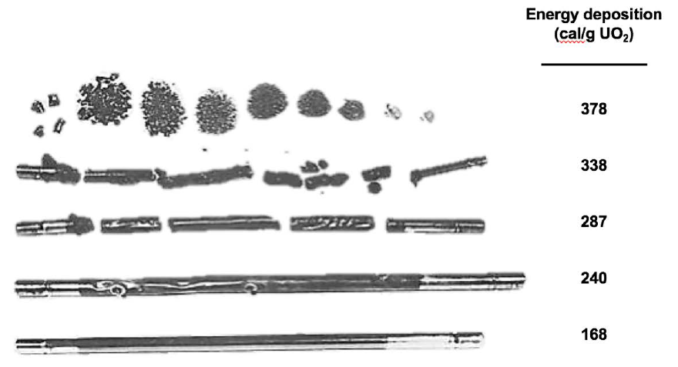
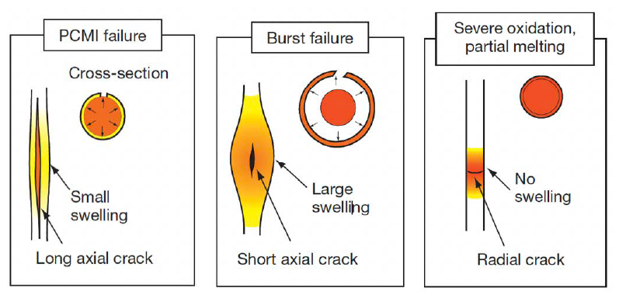
Background and Motivation
Data Gaps for Response of ATF Cr-coated Zr-alloy Cladding under
Power Transient Conditions (RIA)
Pictures of failed fuel following
RIA testing in SPERT*
Reactivity-Initiated Accidents (RIA)
: Power transients in LWRs by sudden reactivity increase due to rapid control rod ejection
Data Gaps for ATF
: Many reports identify data gaps for licensing and several performance criteria of Cr-coated cladding under RIA
including:
  Performance above Cr-Zr eutectic temperature (1332 °C)
  Post-quench ductility
  Coating integrity during swelling/rupture
  Transient boiling phenomena
Three failure modes in RIA transients**

Slide 4
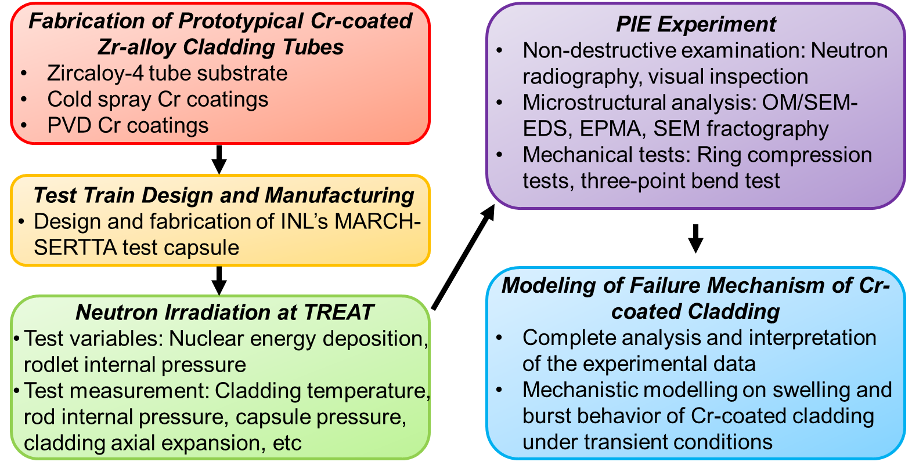


Project Objectives and Status
Investigation of thermal, mechanical, and irradiation response of Cr-coated Zr-alloy claddings (Cold spray, PVD) under RIA conditions, in comparison to uncoated Zr-alloy cladding to demonstrate various cladding failure modes at the later phase transient (post-DNB)
Mid 2025
1. Uncoated – Done
2. Cr-coated
#1 – Done
#2,3 – Late May

Slide 5
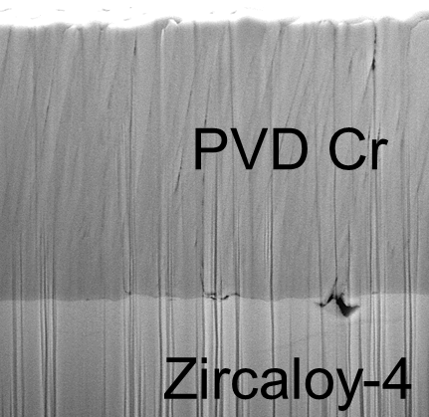
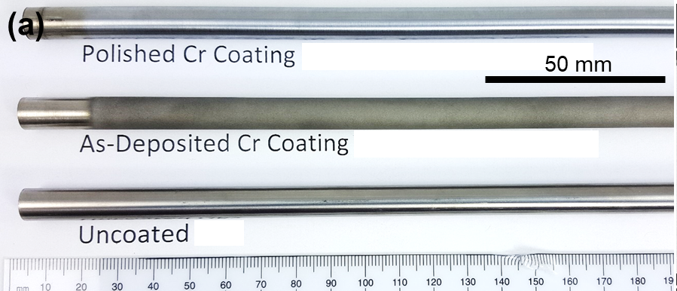
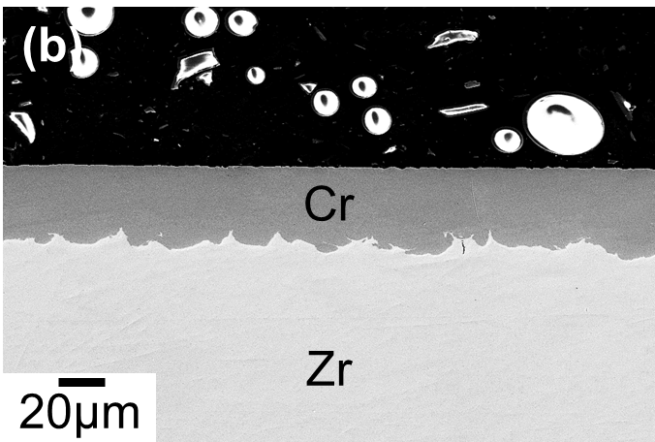
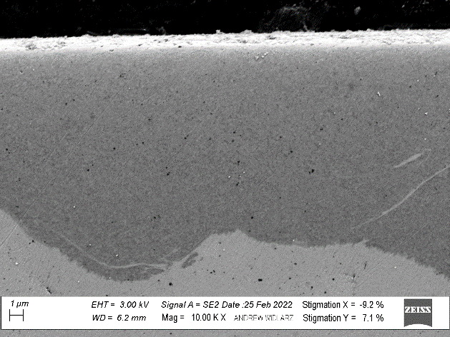
Rodlet & Irradiation Capsule Preparation
Framatome Zircaloy-4 tubes for substrate
Two types of Cr coating have been developed
1. Cold spray technology at UW-M (~25 µm)
- Smooth homogeneous Cr-coating / Nanohardness: 5.34 GPa
2. Physical vapor deposition (PVD) at UIUC and external company (~8 µm)
- Columnar structure of Cr-coating / Nanohardness: 3.67 Gpa
Tube dimensions
- Total tube length: 5.5”
- Coated length: 4.25”
2. Cr-coated Zircaloy-4 tube by PVD
: Cross-sectional SEM images
2µm
Columnar structure of Cr-coating
1. Cr-coated Zircaloy-4 tube by Cold Spray : (a) visual images, (b) cross-sectional SEM image, and (c) High-magnification SEM image
(a)
(b)
(c)
Cold Spray Cr
Zircaloy-4

Slide 6
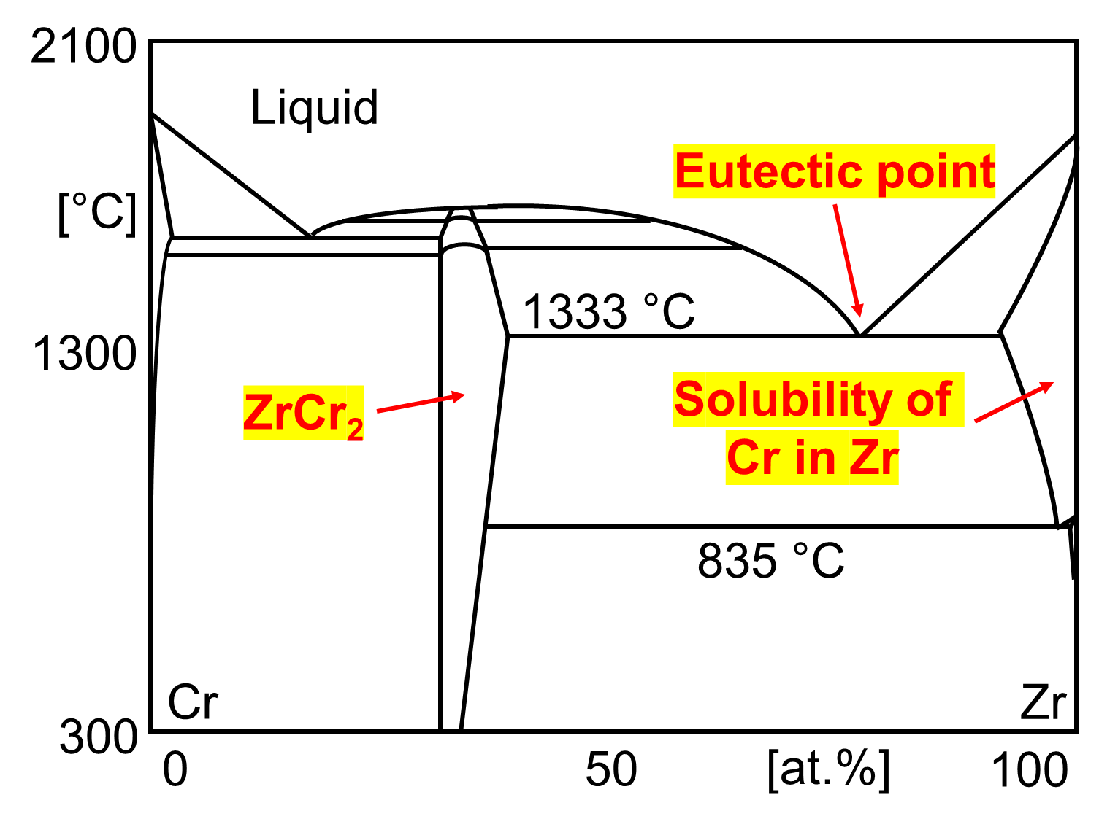
Hypothesis of Cladding Failure MEchanisms
Hypothetical Response of Cr-coated Claddings in RIA Tests
In late phase transient, it is difficult to anticipate the failure modes due to the multifactorial effects of Cr coating
  Cr coating mitigates cladding-coolant interaction
  (i.e., Oxidation of cladding outer surface)
  Adhesion strength at coating/substrate interface would be changed
  by Cr-Zr intermetallic compound formation
  Mechanical properties of the coated cladding would be altered
  by Cr-Zr interdiffusion and partial melting
  Rewetting behavior of coated cladding are different from uncoated
  Zr-alloy due to evolution of surface characteristics
Cr-Zr binary phase diagram redrawn
from published data [K. Zeng, 1993]

Slide 7
RIA Test Matrix
Total 5 RIA Tests Planned in 2023-2025
Test ID | Test Purpose | Target PCT (°C) | Target Energy Deposition (J/g)* | Rodlet Pressure (MPa) | Anticipated Failure Mechanism
NSUF-RIA-10 (CCZ-Zr-3) | Reference test w/o severe oxidation | <1200 | 1000 | 2 | Ballooning and Burst
NSUF-RIA-11 (CCZ-Zr-2) | Reference test w/ severe oxidation | >1332 | 1150 | < 2 (leaked) | Severe oxidation + (Ballooning and Burst)
NSUF-RIA-1 (CCZ-CS-1) | Quantifying eutectic melting, oxidation of CS Cr coating, DNB & film boiling | >1332 | 1150 | 0.1 | Partial melting due to Cr/Zr eutectic
NSUF-RIA-2 (CCZ-CS-2) | Effect of Cr-Zr interdiffusion on ballooning & burst (Comparison w/ CCZ-Zr-3) | <1200 | 1000 | 2 | Ballooning and Burst
NSUF-RIA-3 (CCZ-CS-3) | Effect of Cr/Zr eutectic melting on ballooning & burst (Comparison w/ CCZ-Zr-2) | >1332 | 1150 | 2 | Ballooning and Burst + Partial melting
NSUF-RIA-6* (CCZ-PVD-1) | Effect of Cr diffusion on ballooning & burst response in PVD coating (Comparison w/ CCZ-CS-2) | <1200 | 850 | 2 | Ballooning and Burst
Done
RIA test for the PVD sample is canceled due to the budget limitation
In CCZ-Zr-2 test, there was a pressure leakage in the rodlet (< 2MPa)
RIA tests for two more CS Cr-coated rodlets are planned in late May 2025
PIE is planned to be finished by September 2025

Slide 8
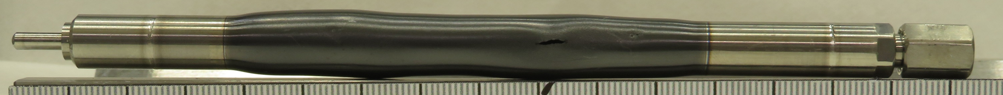
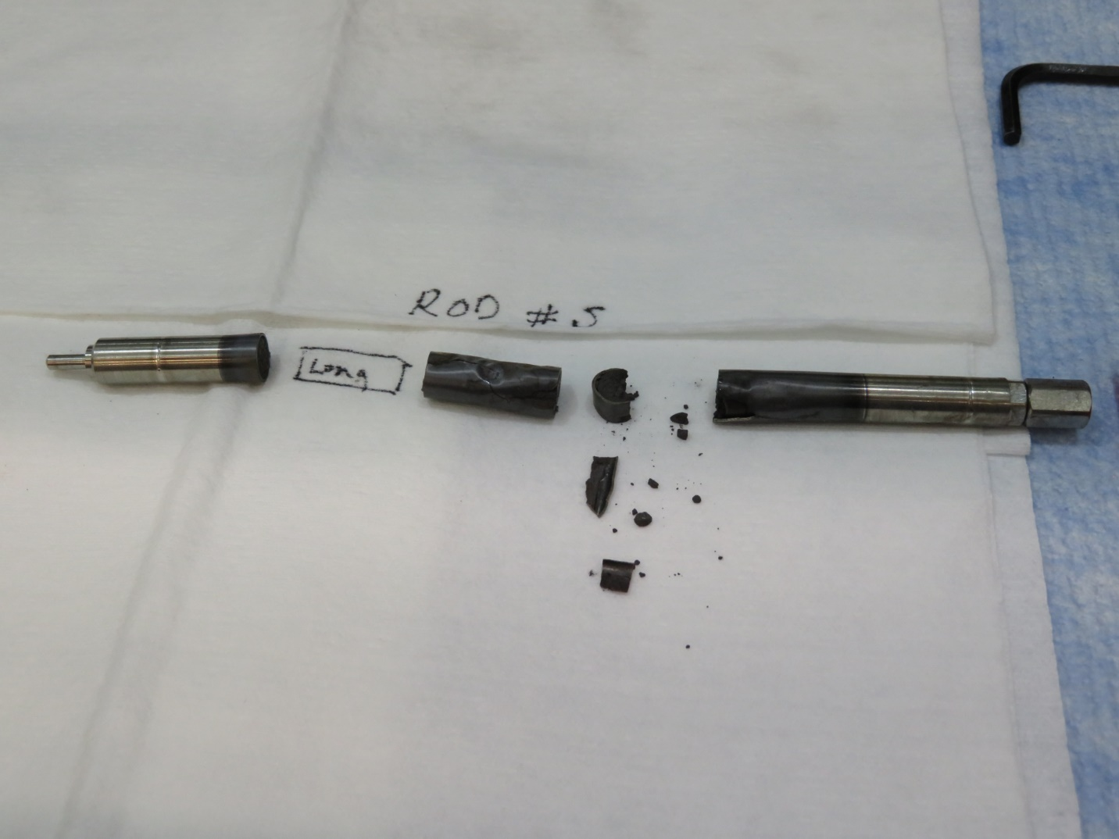
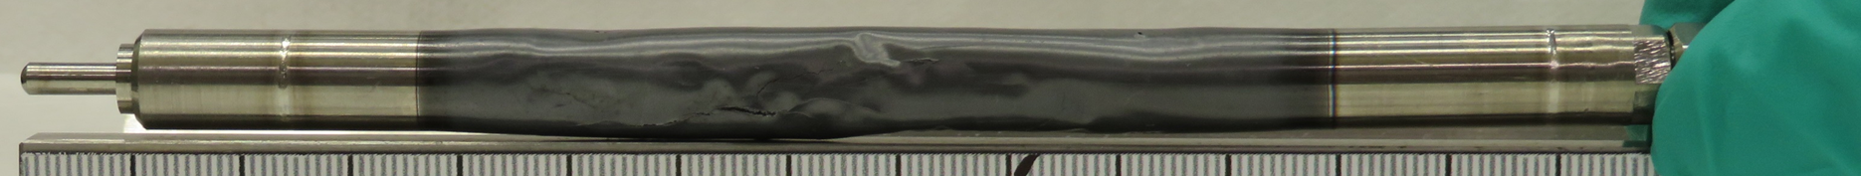
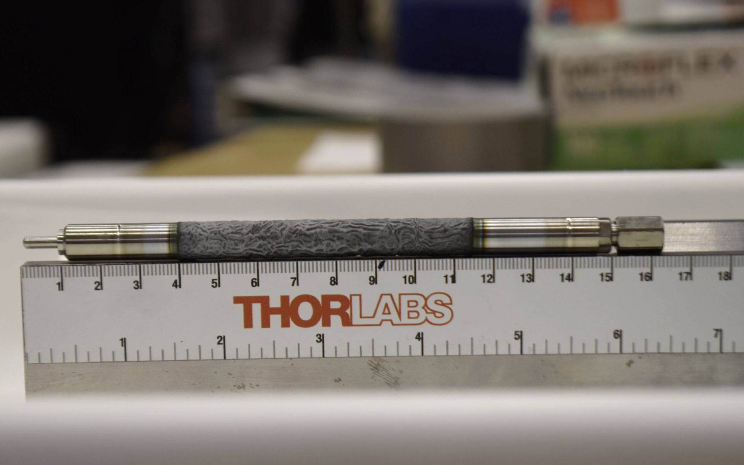
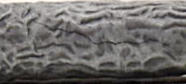
RIA Test Results
Visual observation for post-irradiation CCZ-Zr-3 / Zr-2 / CS-1
CCZ-Zr-3: Ballooning and burst occured w/ small burst opening (~ 3 mm x 1 mm)
CCZ-Zr-2: Severe oxidation w/ large axial crack & very brittle characteristic / Unclear ballooning and burst
CCZ-CS-1: Wrinkled Cr-coating layer (i.e., crocodile skin), which is an indicator of the eutectic partial melting
: Axial crack (~ 2 cm), but not sure if it extends to substrate or not
* Crocodile skin is derived by the eutectic partial melting and redistribution of the liquid state by surface tension
CCZ-Zr-3
CCZ-Zr-2

Slide 9
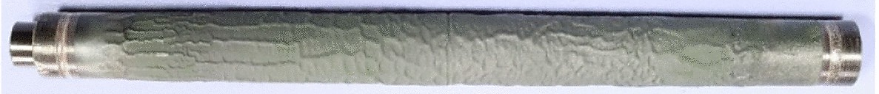
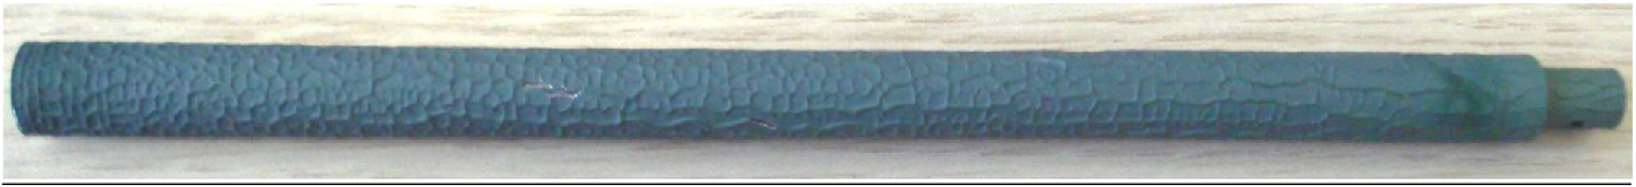
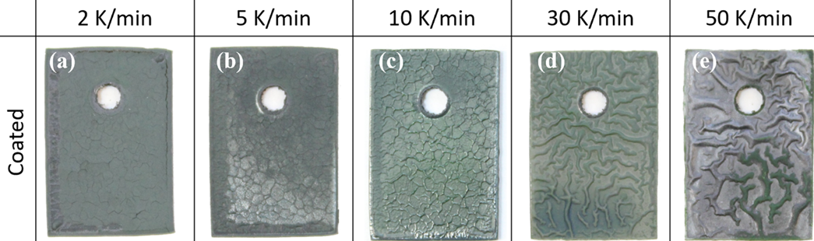
RIA Test Results – Cr-Zr eutectic literature
Brachet et al., CEA, Corrosion Science (2020)
- PVD Cr-coating on M5, 10-20 µm, HT oxidation for 100s at 1400 °C followed by water quenching
Steinbrueck et al., KIT (QUENCH program), High Temperature Corrosion of Materials (2024)
- PVD & CS Cr-coating on OPZ, 10 or 25 µm, HT oxidation > 1500 °C followed by water quenching
Kim et al., KIT, Journal of Nuclear Material (2023)
- PVD Cr-coating on Zr-4, 17 µm, 1380 °C oxidation w/ various heating rate (2-50 K/min) w/ argon gas cooling
1. CEA
3. KIT
2. KIT
UW-
TREAT
‘Crocodile skin’ is commonly observed in HT oxidation and quenching
tests w/ Cr-coated Zr, however CCZ-CS-1 shows most severe protrudes

Slide 10
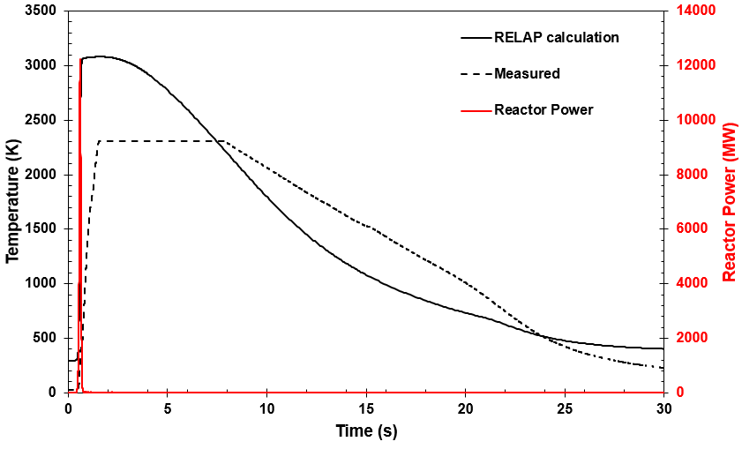
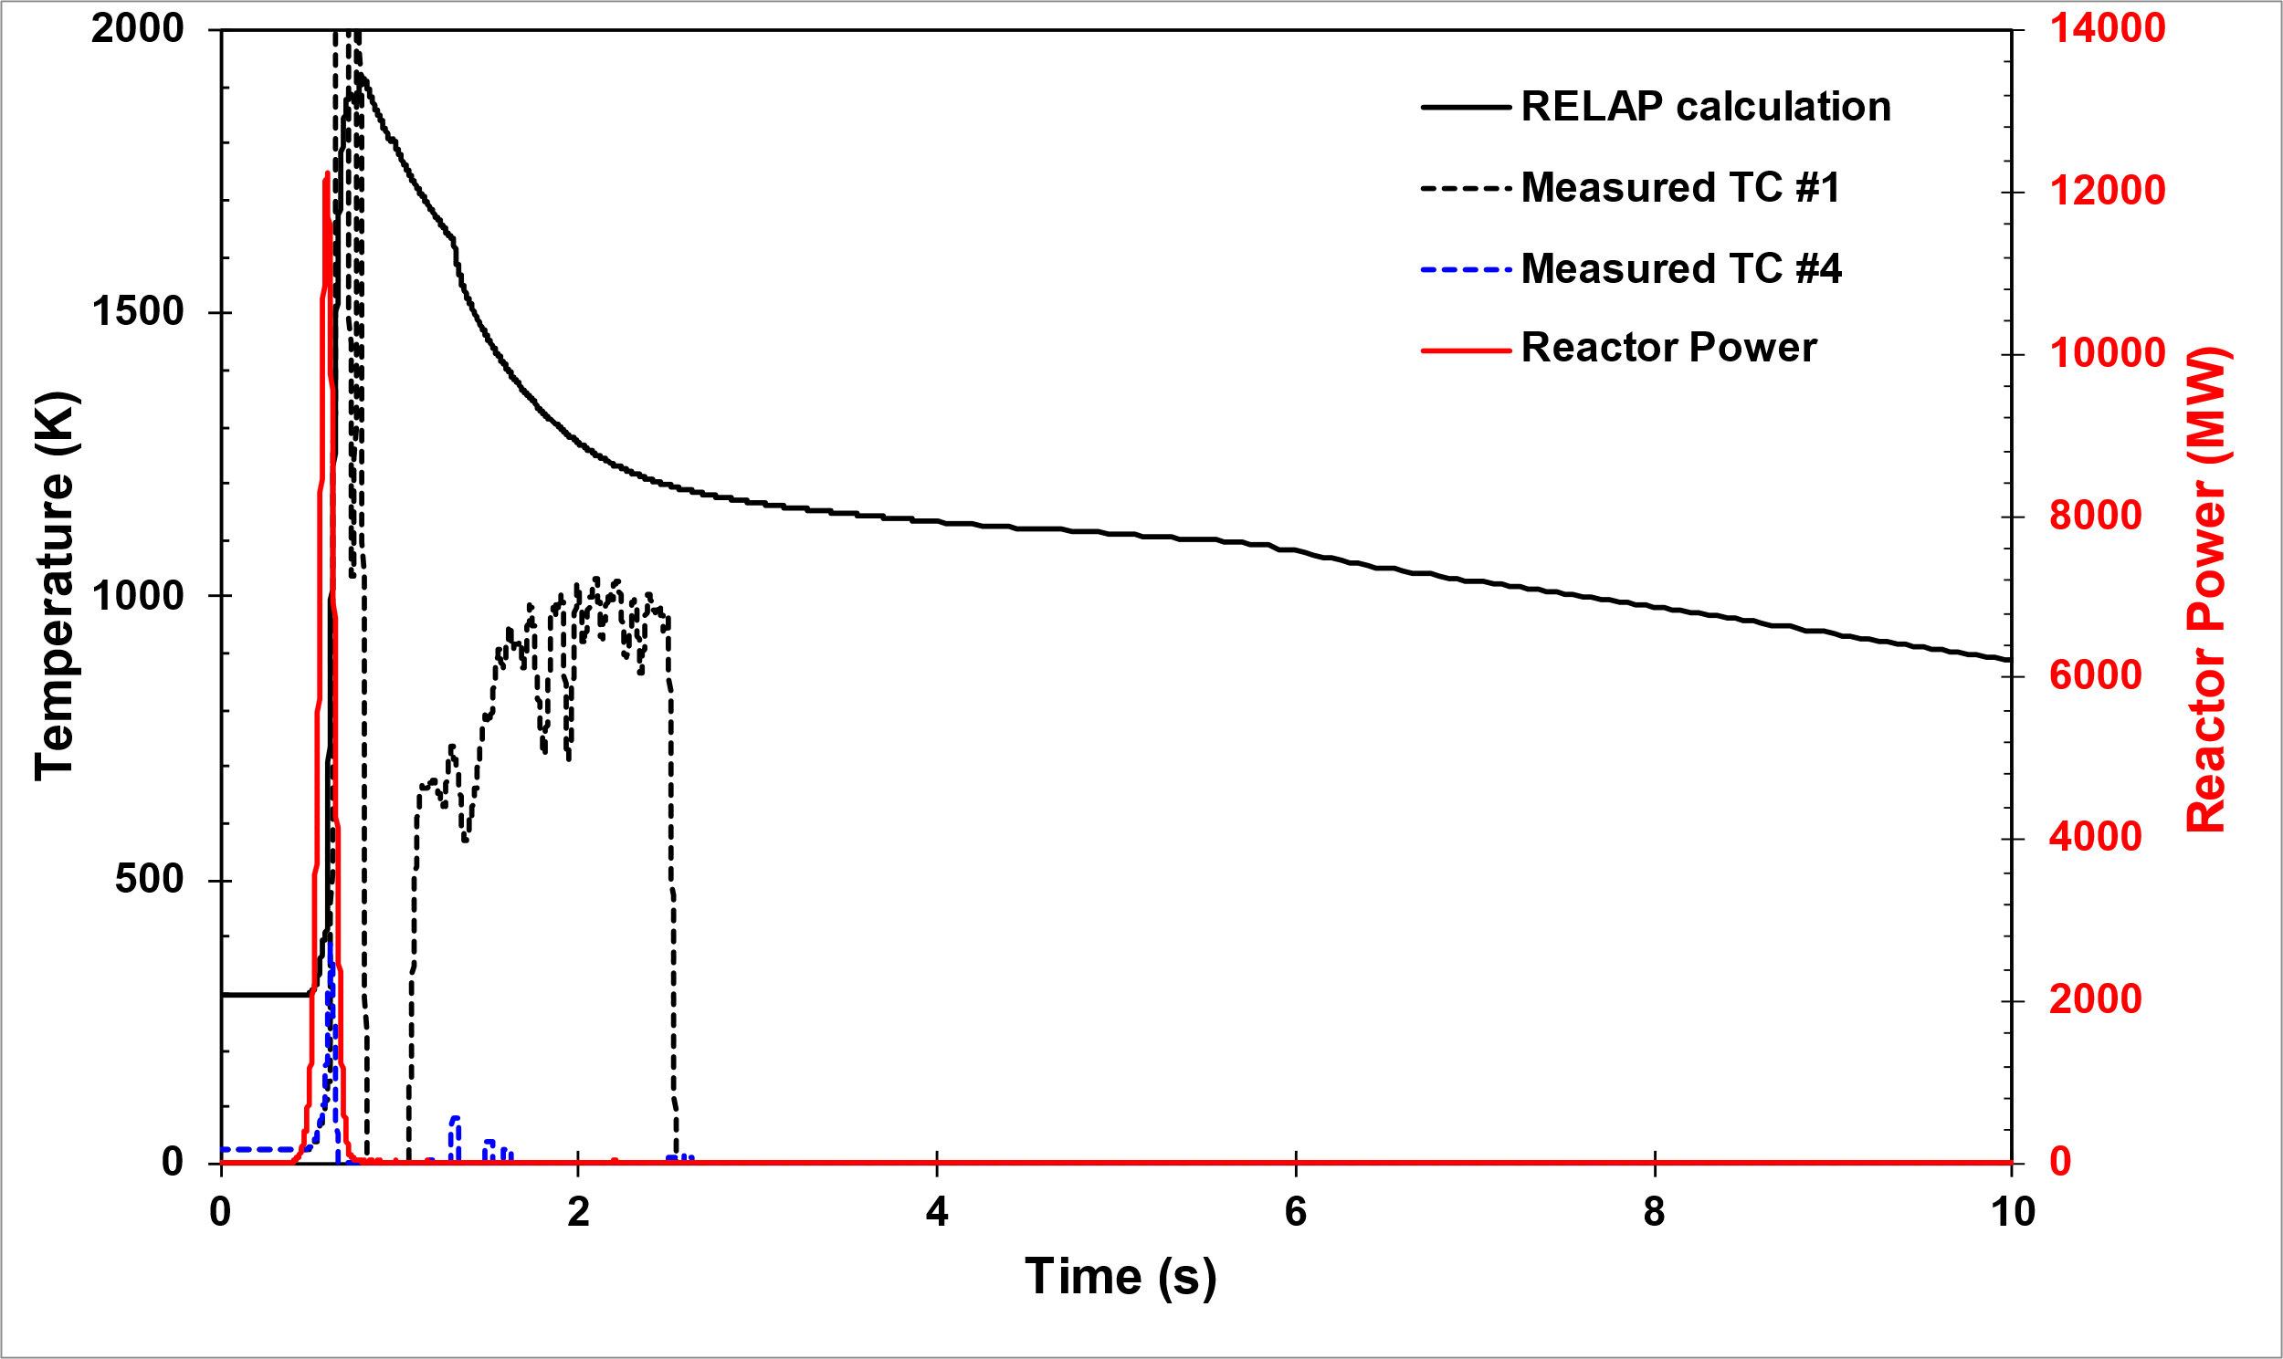
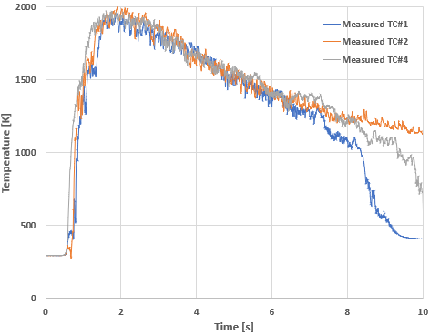
RIA Test Results – RELAP analysis
CCZ-Zr-3 (1000J/g & 2 MPa)
- Centerline fuel temperature : Higher peak temperature than measured data due to TC’s thermal response
- Cladding temperature : RELAP results shows higher temperaturethan the Cr-Zr eutectic point with PCT of 1470 °C (RELAP)
(Higher than Cr-Zr eutectic point for 0.4 seconds)
CCZ-Zr-2 (1150J/g & <2 MPa)
- PCT : 1645 °C (RELAP) (Higher than Cr-Zr eutectic point for 0.65 seconds)
CCZ-CS-1 (1150J/g & 0.1 MPa)
- PCT : 1722 °C (measured) (Higher than Cr-Zr eutectic point for 3.36 seconds)
PCT varies according to the multiplication factor in RELAP analysis
- With the conservative factor, PCT of CCZ-Zr-3 is 1725 °C and of CCZ-Zr-2 is 1829 °C *RELAP analysis of CCZ-CS-1 is under progress
CCZ-Zr-3
CCZ-Zr-3
CCZ-CS-1
TC failed
Fuel centerline temperature history w/ RELAP
Cladding temperature history w/ RELAP
Measured cladding temperature history

Slide 11
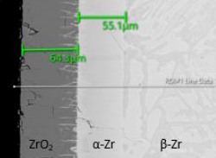

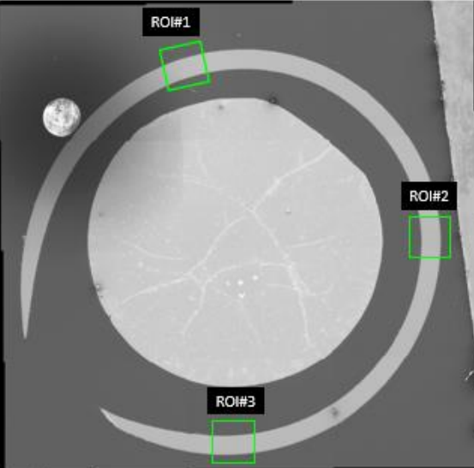
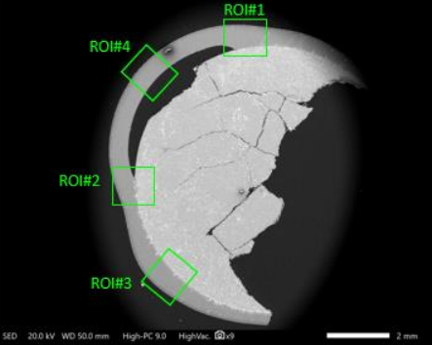
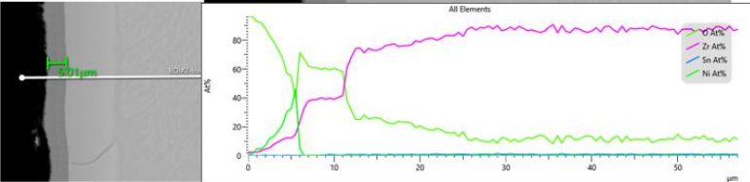
RIA Test Results – PIE
CCZ-Zr-3 (1000J/g & 2 MPa)
- Balloon and burst failure w/ permanent deformation in the cladding peaked ~27% strain
- Oxide thickness: 9.5 µm
CCZ-Zr-2 (1150J/g & <2 MPa)
- Only localized balloon and burst w/ permanent deformation in the cladding peaked ~9.5% strain
- Oxide thickness: 64 µm
- EDS scan confirmed the presence of the ZrO₂ layer, α-Zr layer, and β-Zr layer
- Diffusion of uranium into the Zr cladding is observed
CCZ-Zr-2 ROI#1
CCZ-Zr-3 Cross section SEM image
CCZ-Zr-2 Cross section SEM image
CCZ-Zr-3 ROI#2

Slide 12
Future Works
Two CS Cr-coated rodlets will be irradiated on late May, 2025
Basic PIE will be performed by Sep. 2025
Our final goal is to investigate the failure mechanism of
Cr-coated cladding under RIA

Slide 13

Thanks for your attention
Questions?
WooHyun Jung
University of Wisconsin-Madison
wjung37@wisc.edu

Slide 14
RIA Test Results
PCT: 1470 °C
PCT: 1645 °C

Slide 15
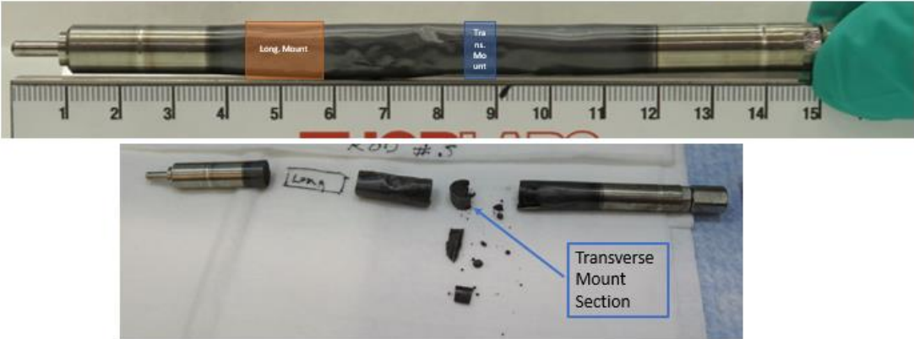
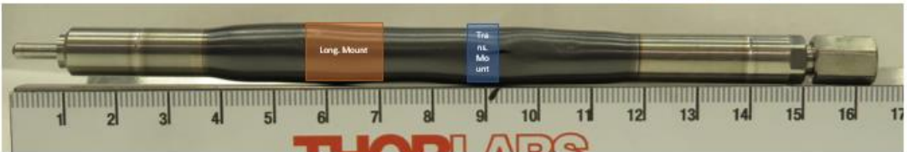
RIA Test Results

