Slide 1
EPRI Led Nuclear Nondestructive Evaluation NSUF Industry Projects:
- UT Sensor Irradiation and PIE: NCSU and ORNL
- NDE of RPV Surveillance Samples: Westinghouse
Dr. Joe Wall (PI, jwall@epri.com)
Principal Technical Leader – EPRI - Nuclear
NSUF Annual Program Review Meeting
4/15/2025 - 4/17/2025

Slide 2
NSUF 1.1 Sensor Irradiation and Post Irradiation Examination (PIE) of Acoustic Sensors and Adhesive Couplants (2021-2024)
NCSU PULSTAR Reactor and Intense Positron Beam Facility (A. Hawari)
ORNL LAMDA Laboratory (J. Schmidlin)
“Irradiation of Sensors and Adhesive Couplants for Application in LWR Primary Loop Piping and Components”
J. J. Wall et al., Nuclear Engineering & Design, 414, 112594 (2023)
J. J. Wall et al., NSUF Final Report (2025)

Slide 3
NSUF 1.1 Sensor Irradiation and Post Irradiation Examination (PIE) of Acoustic Sensors and Adhesive Couplants
Motivation: The industry would like to develop capabilities to monitor flaws online in primary loop piping and components using semi-permanently mounted acoustic sensors.
For some locations, e.g., hot and cold leg nozzles, fast neutron irradiation effects on sensors and adhesive couplants need to be understood.
NSUF Contributions:
- R&D funding directly to EPRI
- NCSU: Sample assembly irradiation at PULSTAR reactor, in-situ ultrasonic data collection and positron annihilation spectroscopy
- ORNL: Electron microscopy - imaging and EBSD, x-ray microanalysis

Slide 4
NSUF 1.1 Sensor Irradiation and Post Irradiation Examination (PIE) of Acoustic Sensors and Adhesive Couplants
Eight sample assemblies were created for irradiation in the NCSU PULSTAR reactor.
The assemblies consisted of piezoelectric sensors adhered to aluminum pucks using various adhesive couplants.
  Piezoelectric sensors were lithium niobate and bismuth titanate
  Adhesive couplants were alumina based, aluminosilicate, zirconia based and epoxy.
  Acoustic measurements were made prior to irradiation at EPRI
Acoustic data was collected in-situ during sample irradiation.

Slide 5
NSUF 1.1 Sensor Irradiation and Post Irradiation Examination (PIE) of Acoustic Sensors and Adhesive Couplants
The bismuth titanate samples were arranged in an upper chamber open to air while the lithium niobate samples were arranged in a hermetically sealed lower chamber (to contain ³H).

Slide 6
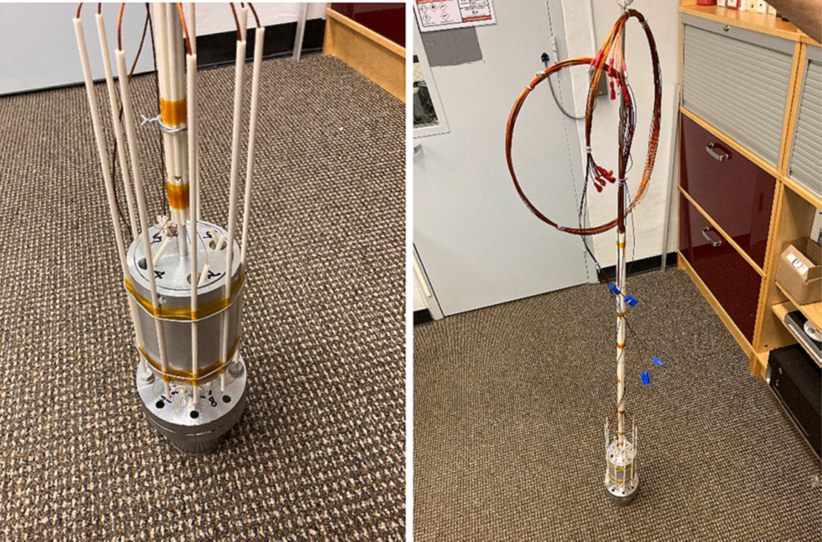
NSUF 1.1 Sensor Irradiation and Post Irradiation Examination (PIE) of Acoustic Sensors and Adhesive Couplants
The samples were wired and attached to a pulser-receiver for in-situ data collection during irradiation.

Slide 7
NSUF 1.1 Sensor Irradiation and Post Irradiation Examination (PIE) of Acoustic Sensors and Adhesive Couplants
The target fluence was 5 x 10¹⁶ n/cm² (E > 1MeV) which was determined from neutron transport calculations in the vicinity of the hot and cold leg nozzle dissimilar metal welds.
Three of the eight samples were found to generate usable ultrasonic waveforms beyond the target neutron fluence.
  Sample EPRI-4: Bismuth titanate sensor adhered with aluminosilicate couplant
  Sample EPRI-7: Lithium niobate with high temperature epoxy couplant.
  Sample EPRI-8: Lithium niobate with high temperature epoxy couplant.

Slide 8
NSUF 1.1 Sensor Irradiation and Post Irradiation Examination (PIE) of Acoustic Sensors and Adhesive Couplants
Signal to noise ratios of the first reflection in the acoustic waveforms as a function of fast neutron fluence for samples EPRI-4 (upper left), EPRI-7 (upper right) and EPRI-8 (lower right)

Slide 9
Pre and Post Irradiation Electron Microscopy

Slide 10
NSUF 1.1 Sensor Irradiation and Post Irradiation Examination (PIE) of Acoustic Sensors and Adhesive Couplants
Unirradiated Sample: (a) Backscatter electron micrograph showing the bismuth titanate sensor (white) aluminosilicate couplant (dark gray) and aluminum substrate (lighter gray). (b) Backscatter electron micrograph of the bismuth titanate sensor microstructure. (c) Backscatter electron micrograph showing poor adhesion to substrate bonding. This sample showed poor acoustic behavior and was therefore not irradiated.

Slide 11
NSUF 1.1 Sensor Irradiation and Post Irradiation Examination (PIE) of Acoustic Sensors and Adhesive Couplants
Backscatter electron micrograph of sample assembly EPRI-4 showing adhesion of the bismuth titanate sensor (white) to the couplant (dark gray) and the substrate (lighter gray) to the aluminosilicate couplant (dark gray). This sensor assembly gave usable ultrasonic data throughout the irradiation campaign. Note the artifact at the top is a wire soldered to the sensor that was cut by the plane of polish.
Backscatter electron micrograph of sample EPRI-8 showing – from top to bottom - the solder ball for the electrical connection (white), lithium niobate sensor (gray), epoxy couplant (black) and aluminum substrate (dark gray).

Slide 12
NSUF 1.1 Sensor Irradiation and Post Irradiation Examination (PIE) of Acoustic Sensors and Adhesive Couplants
Backscattered electron micrograph and EDX spectra of an Na-O feature found in sample EPRI-4 at the aluminosilicate couplant – bismuth titanate sensor interface. These features appear to have formed in between polishing and examination and may be an artifact of the humidity in the lead storage vaults.

Slide 13
NSUF 1.1 Sensor Irradiation and Post Irradiation Examination (PIE) of Acoustic Sensors and Adhesive Couplants
Conclusions:
Three assemblies of the eight tested produced usable ultrasonic date up to beyond the target fluence.
SEM PIE showed good and poor adhesion depending on sample.
  EDX showed that irradiation did not cause chemical segregation.
PALS and DBS showed that 0.1 ppma vacancy defects were introduced into the microstructure.
Irradiation to the target fluence did not appreciably change the S:N ratio for lithium niobate or bismuth titanate sensors.
  It is believed that the failures occurred due to failure of the couplants.
  Of the couplants studied, the high temperature epoxy worked best.
For more details see Nucl. Eng. Des. 414, 112594 (2023) and the NSUF Final Report (2025).

Slide 14
NSUF 2.1 Nondestructive Evaluation (NDE) of Fracture Properties in Irradiated Light Water Reactor Pressure Vessel Steels (2025-2026)
Westinghouse Churchill Site Hot Cell Laboratory (C. Cmar)
New Project

Slide 15
NSUF 2.1 NDE of Fracture Properties in Irradiated Light Water Reactor Pressure Vessel Steels
Motivation: Operating LWRs to 80 or even 100 years will require more RPV surveillance sample test data than was originally anticipated.
There is a looming sample scarcity issue. In some cases, samples are already being reconstituted and reirradiated.
Perhaps one or a combination of NDE methods can offer supplemental data for RPV fracture mechanics calculations.
NSUF Contribution:
- Westinghouse: Sample retrieval, hot cell access and technical assistance with in-cell NDE measurements.

Slide 16
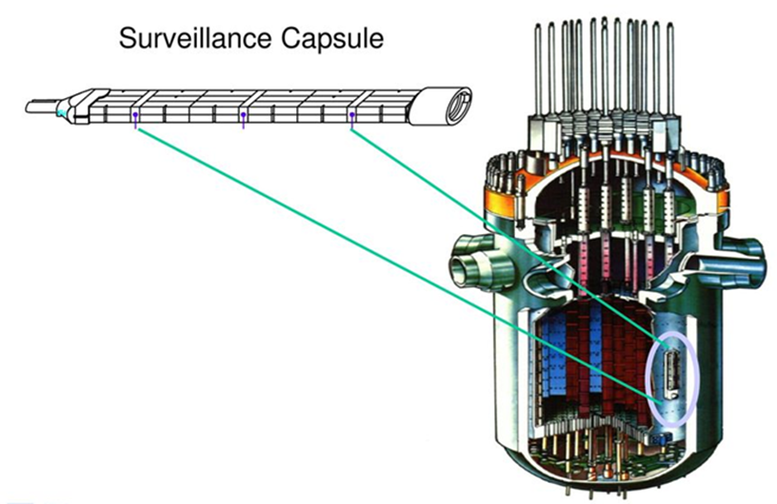
NSUF 2.1 NDE of Fracture Properties in Irradiated Light Water Reactor Pressure Vessel Steels
Surveillance samples are sacrificial RPV steel samples that are inside the reactor and are removed periodically to determine fracture properties used to perform fracture mechanics calculations to ensure reactor safety as part of plant AMPs.
The scope of this project will be to benchmark nonstandard NDE techniques to assess the known fracture properties in broken Charpy surveillance samples at Westinghouse.

Slide 17
NSUF 2.1 NDE of Fracture Properties in Irradiated Light Water Reactor Pressure Vessel Steels
Surveillance samples of interest:
Ginna forgings (2) irradiated to ~6 x 10¹⁹ n/cm² and Farley Units 1 and 2 rolled plates irradiated to ~8 x 10¹⁹ n/cm².
NDE Techniques of interest:
Linear ultrasonics (internal friction, velocity and attenuation) – Funded by EPRI, performed by The Aerospace Corporation.
Magnetic methods (3MA) – funded by EPRI, performed by Fraunhofer IZFP

Slide 18
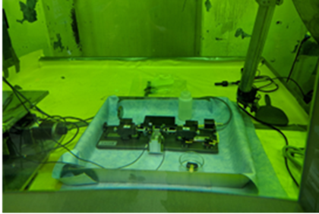
NSUF 2.1 NDE of Fracture Properties in Irradiated Light Water Reactor Pressure Vessel Steels
Left shows an acoustic translation stage used for ultrasonic measurements mounted inside one of the hot cells at the Westinghouse Churchill facility (used for a prior study).
Right shows a Gantt chart of the project timeline

