Slide 1
Irradiation of GaN HEMTs and SiC JFETs for Near-Core Rad-Hard Electronics
NSUF Annual Program Review
Kyle Reed
17 April 2025

Slide 2
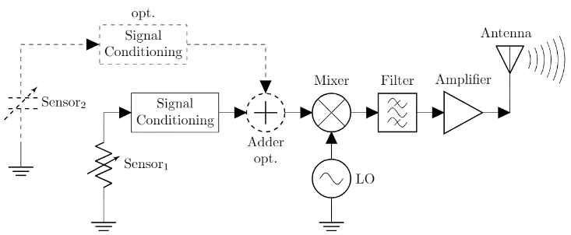


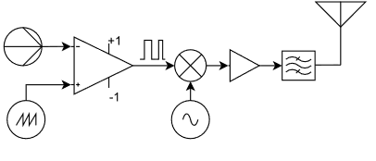
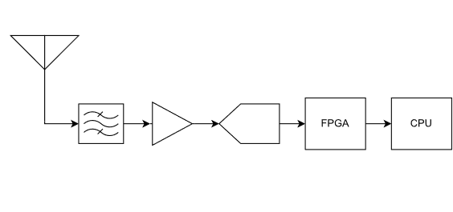
Project Overview
Research Purpose and Scope:
Commercially available electronics technologies for present day, in-service nuclear reactor sensing and communications are unsuitable due to high radiation and high temperature environments
This project investigated and demonstrated the suitability of gallium nitride (GaN) HEMT-based electronics for reactor sensor interfacing and wireless communications
Successful completion advances the state-of-the-art in harsh environment electronics technologies for present and future advanced reactor applications
Low complexity transmitter examples
Participants:
Oak Ridge National Laboratory
Kyle Reed (PI)
Nance Ericson
Dianne Bull Ezell
Brett Witherspoon
Lloyd Clonts
Tyler McCormick
Kevin Deng
Emma Brown
Adam Buchalter
The Ohio State University
Siddharth Rajan
Raymond Cao
Chandan Joishi
Jack Lanza
Hyunsoo Lee
John Cobbinah
Adithya Balaji
High complexity receiver

Slide 3


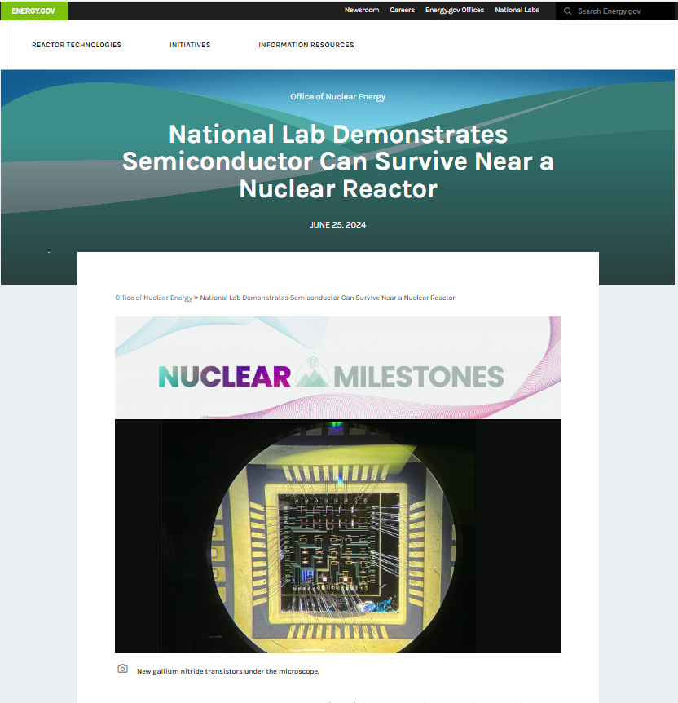
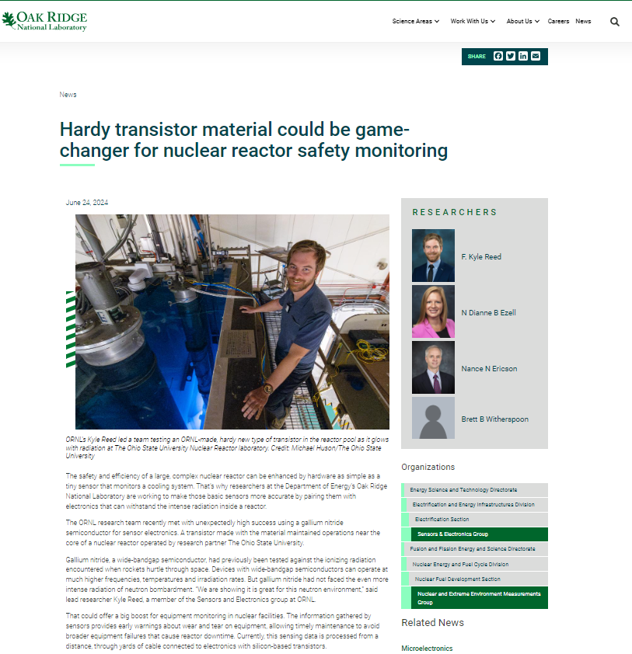
Media Attention

Slide 4
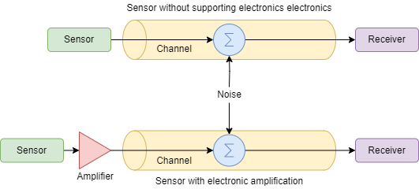
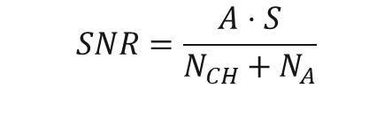
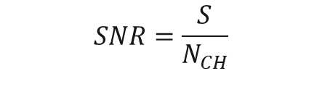
Why Radiation-Hardened Electronics?
Placing sensors and associated electronics closer to a nuclear reactor core will improve reactor control and operation through increased signal accuracy, precision, and fidelity resulting in safer and more efficient energy production
Electronics placed closer to sensors can multiplex and/or processes signals, reduce bandwidth for transmission, and reduce cabling and penetration requirements lowering costs and increasing infrastructural integrity
$$SNR=\frac{S}{N_{CH}}$$
$$SNR=\frac{A⋅S}{N_{CH}+N_{A}}$$

Slide 5
Si-Based Electronics Components Radiation Limits
 | Displacement effect [1] | Total ionizing dose effect [2]
Diodes/ Photodiodes | ↑ leakage current; ↑ forward voltage threshold | ↑ photocurrents
LEDs | ↓ light intensity | ↓ light intensity
BJTs | Current gain degradation; ↓ minority carrier lifetime | Current gain degradation; ↑ leakage current
JFETs | ↑ channel resistivity; ↓ carrier mobilities | Minimal effects
SiC JFETs | ↑ channel resistivity; ↓ carrier mobilities | Minimal effects
MOSFETs | ↑ channel resistivity; ↓ carrier mobilities | Variation threshold voltage; ↑ leakage current
CMOS | ↑ channel resistivity; ↓ carrier mobilities | Variation in threshold voltage; Variations in leakage current
[1] Neamen, Donald A. Semiconductor physics and devices: basic principles. New York, NY: McGraw-Hill,, 2012.
[2] H. Spieler, "Introduction to radiation-resistant semiconductor devices and circuits." AIP Conference Proceedings. Vol. 390. No. 1. American Institute of Physics, 1997.

Slide 6
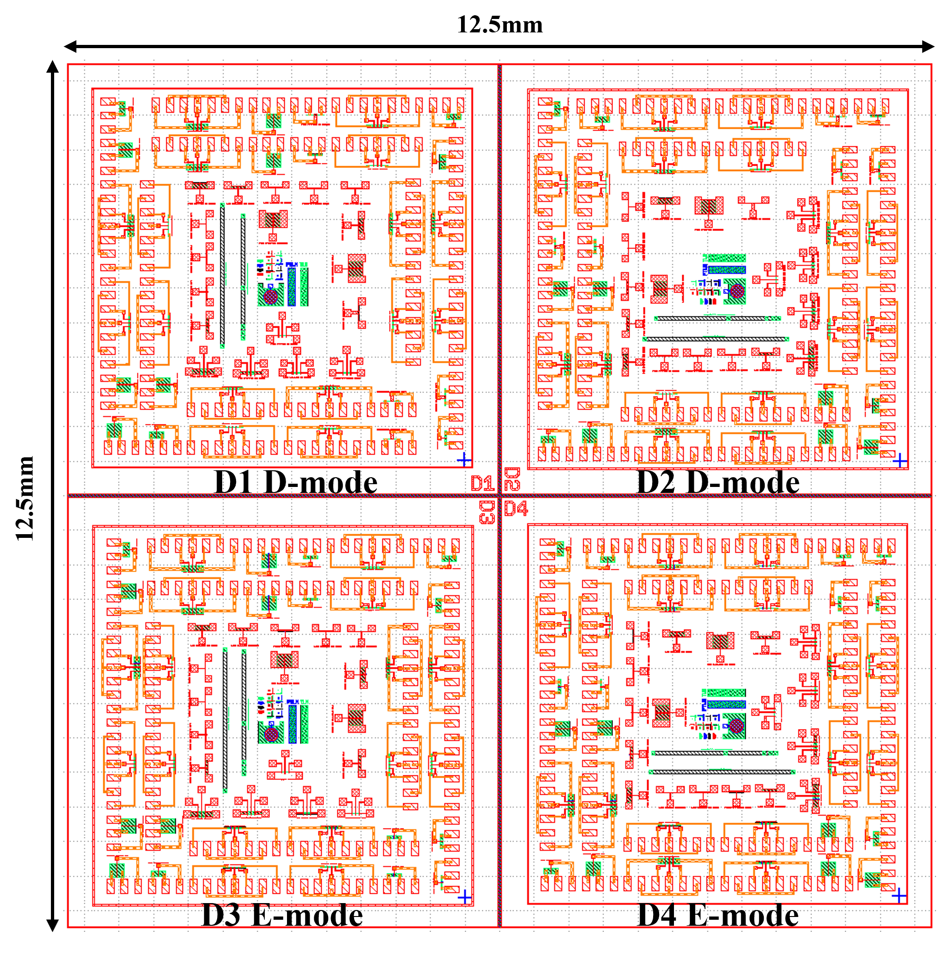
Why GaN?
High bonding in binary and ternary nitrides makes GaN devices intrinsically resistant to radiation induced displacements
Enhancement-mode (E-mode) and depletion-mode (D-mode) device fabrication and operation is possible without requiring gate insulation for the field effect devices
The 2D electron gas (2DEG) allows for channel charges as high as 3x10¹³ cm⁻² without introducing dopants, which allows for high channel mobilities by reducing impurities
GaN HEMTs have been shown to withstand 600 Mrad ionizing dose (neutron limits are under investigation by this team)
D-mode GaN HEMT cross section
E-mode GaN HEMT cross section

Slide 7
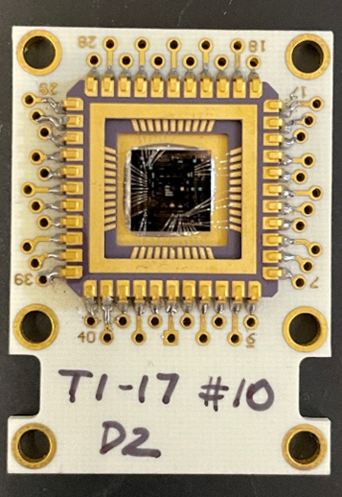
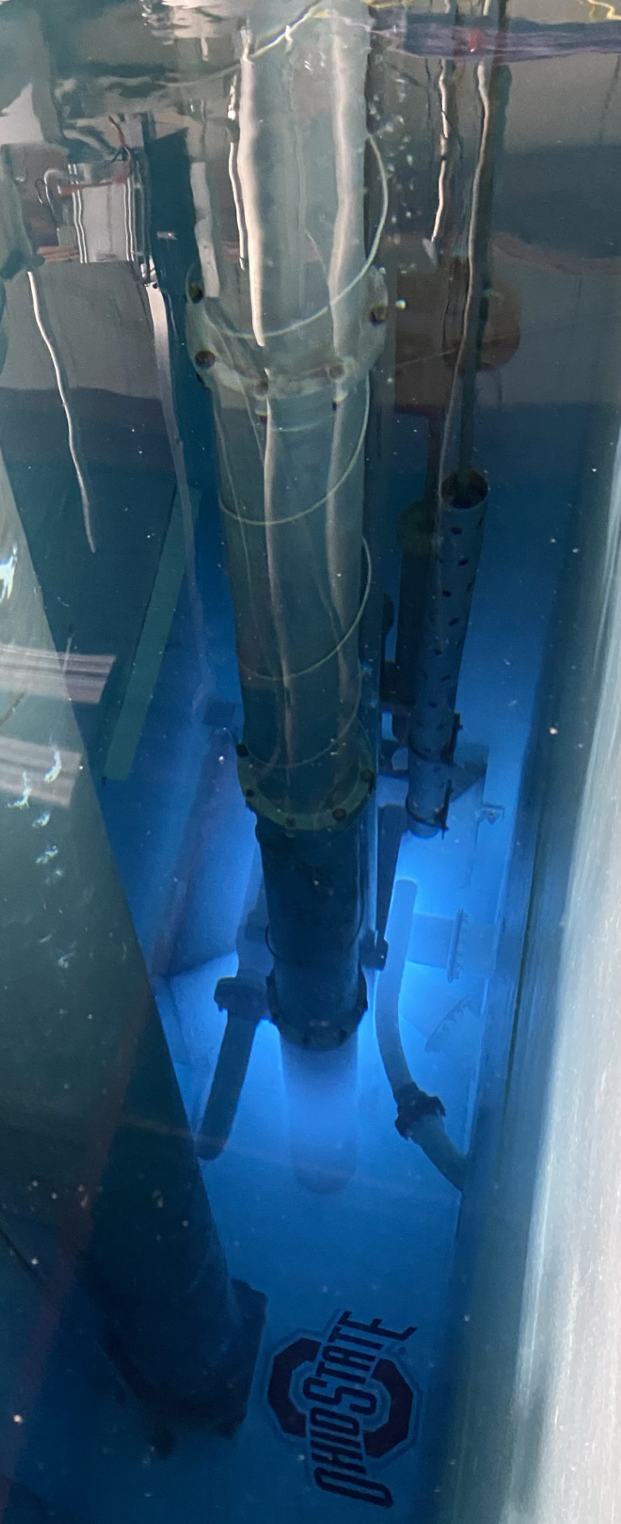
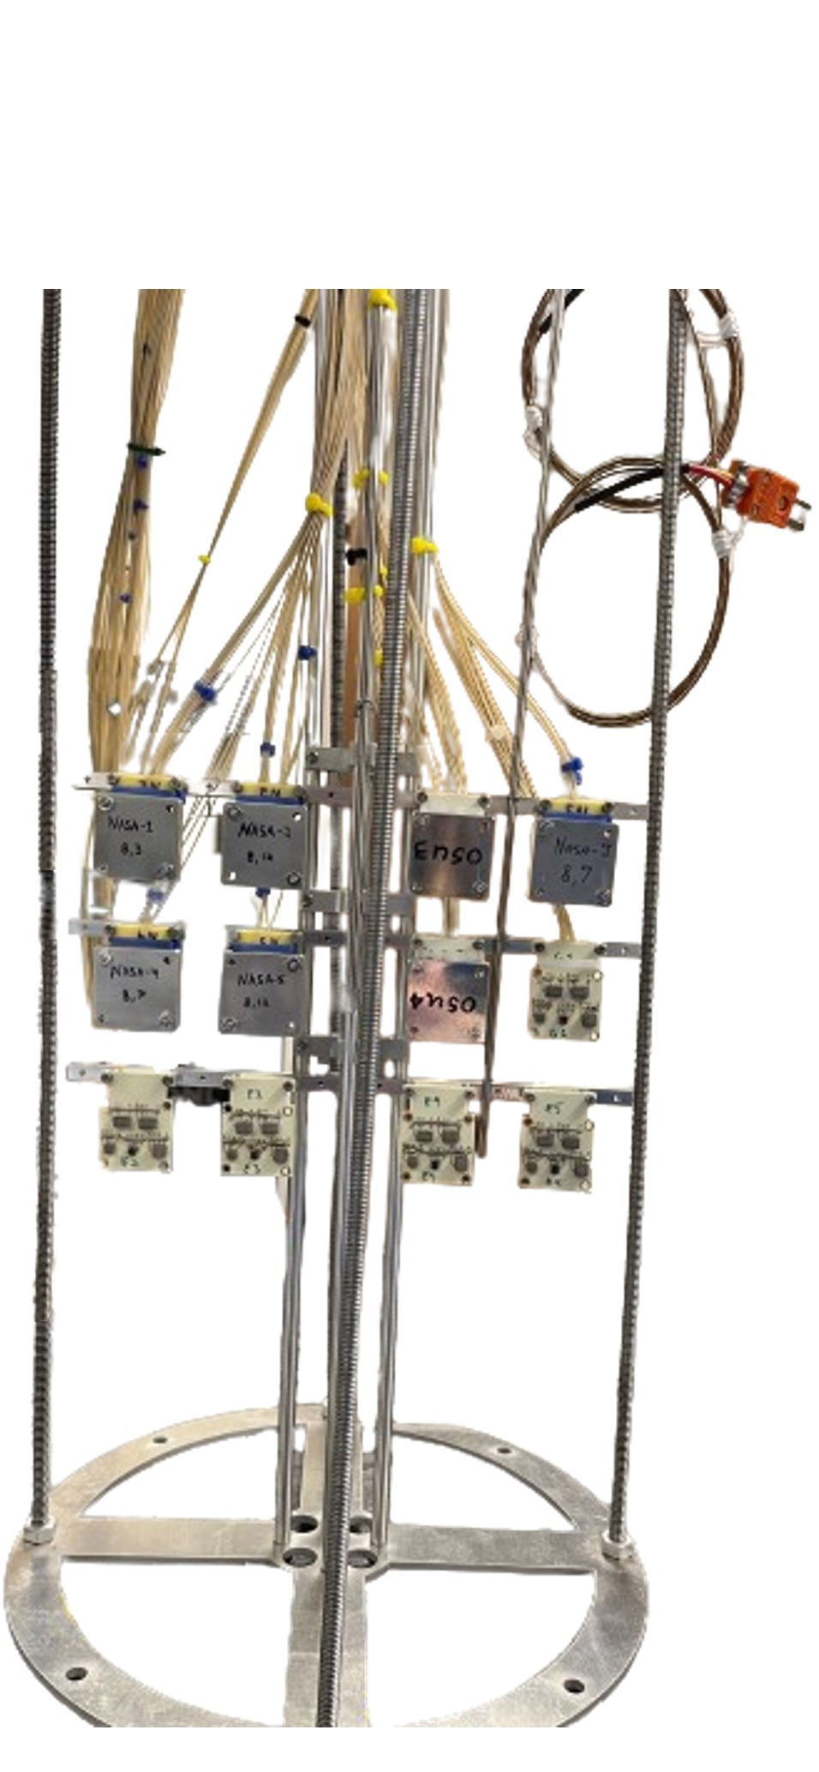
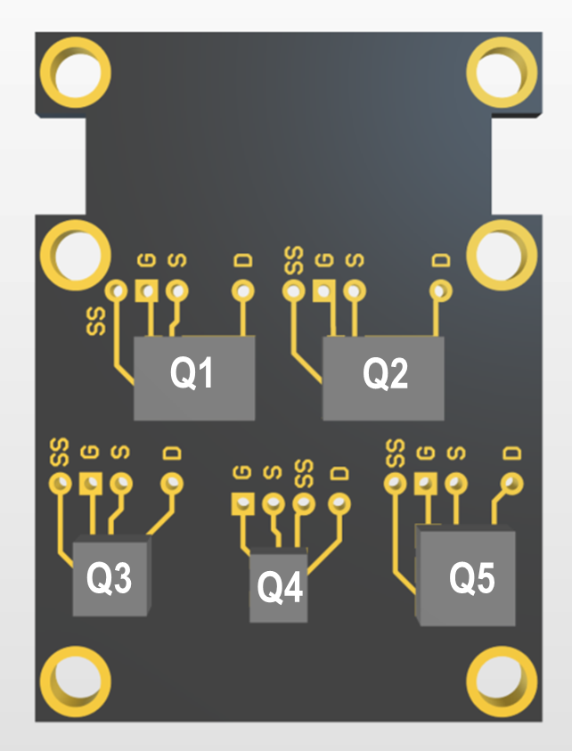
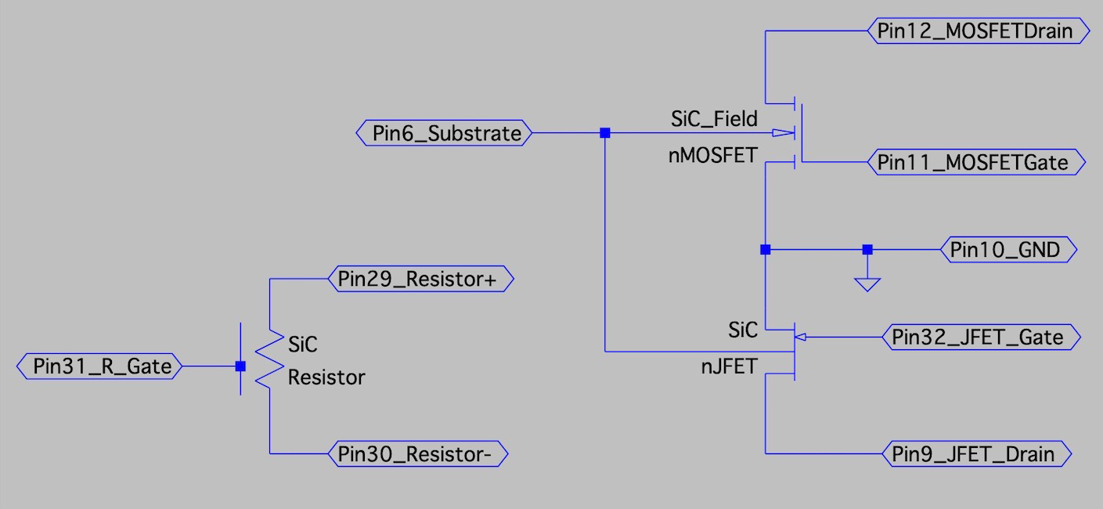
RTE #4881 Simultaneous Irradiation Experiment Description
A dual irradiation experiment was performed in June 2024 in two of OSU’s reactor facilities -- the Auxiliary Irradiation Facility (AIF) and the Dry Well Facility (DWF)
The AIF has a particle flux that is an order of magnitude greater than the DWF
OSU GaN HEMT samples were measured in situ in the AIF
OSU GaN HEMTs, EPC-Space eGaN® HEMTs, and NASA-Glenn SiC JFETs were measured in situ in the DWF for a technology comparison irradiation
OSU Fabricated GaN HEMTs
EPC-Space eGaN® HEMTs
NASA-Glenn
SiC JFETs

Slide 8
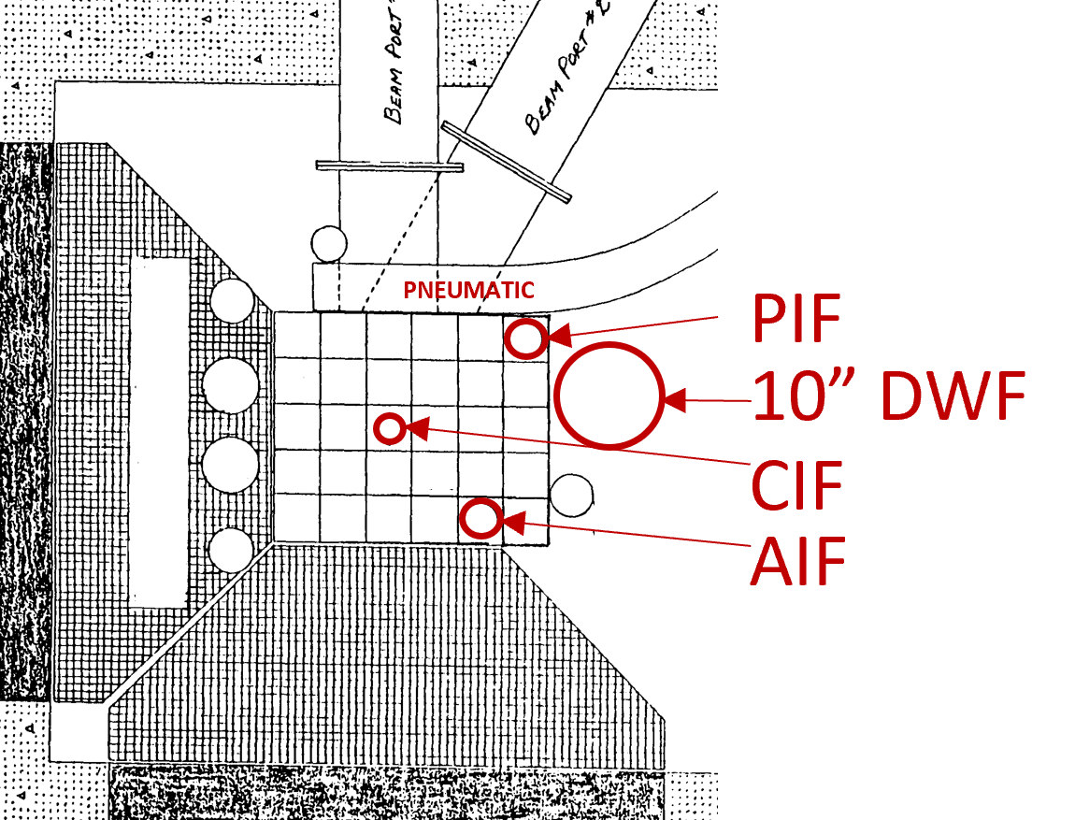
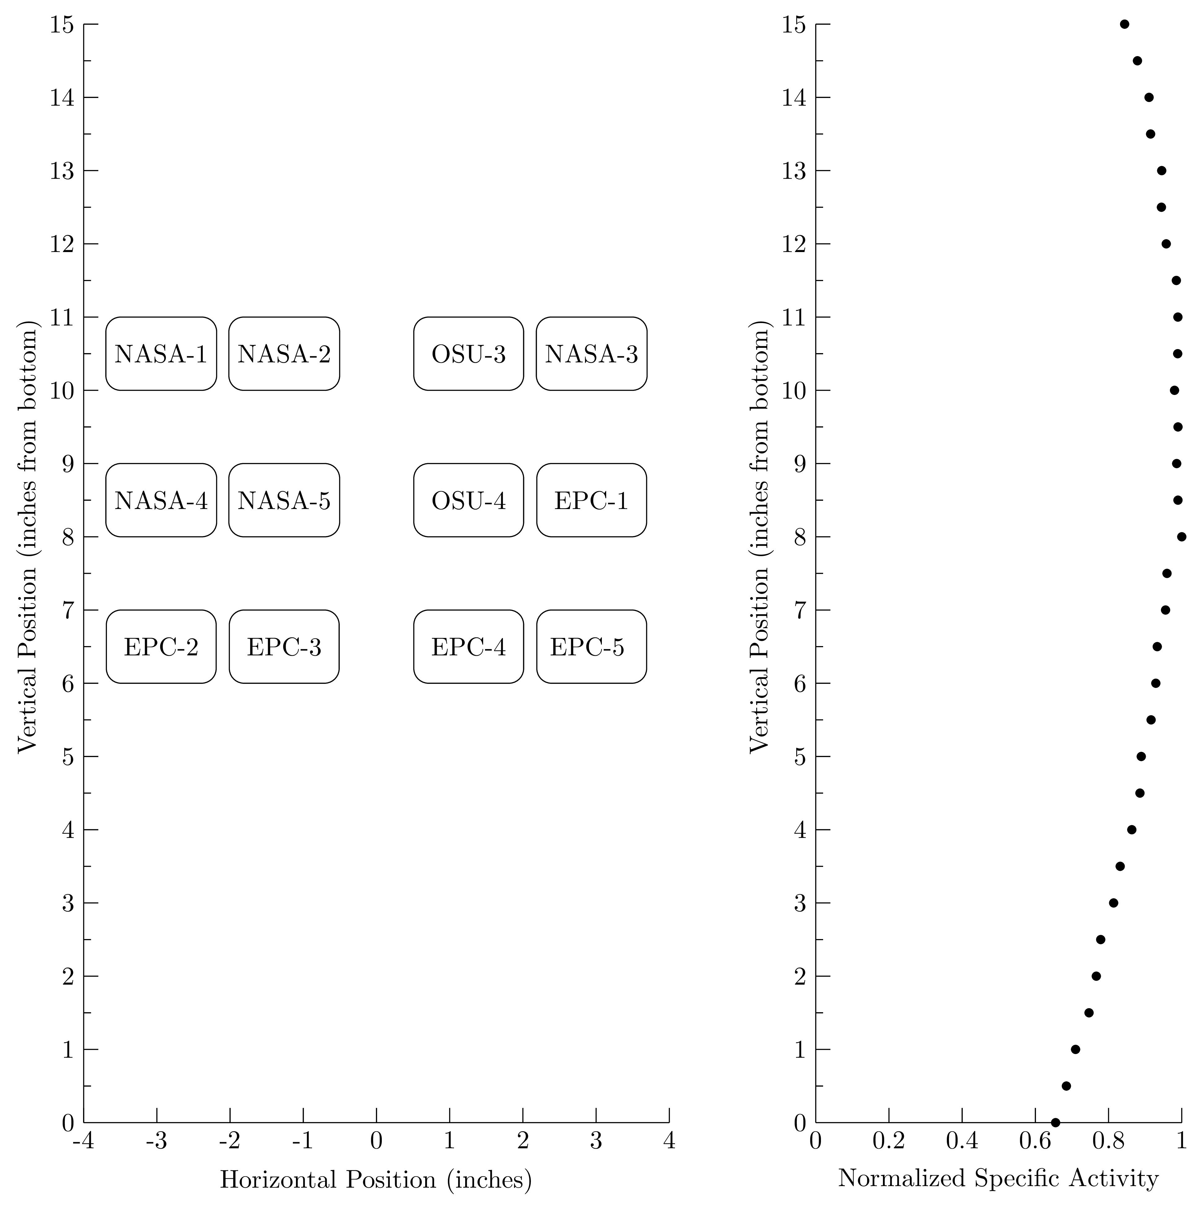
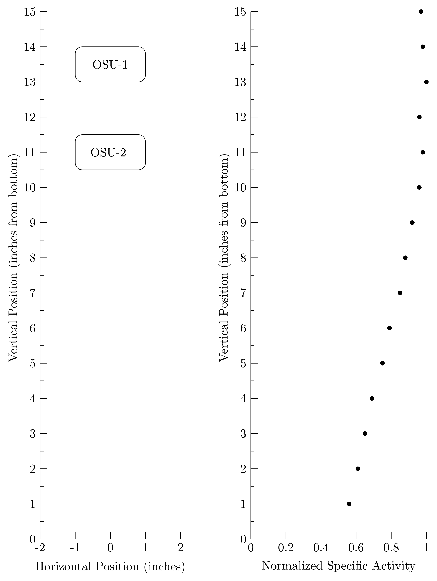
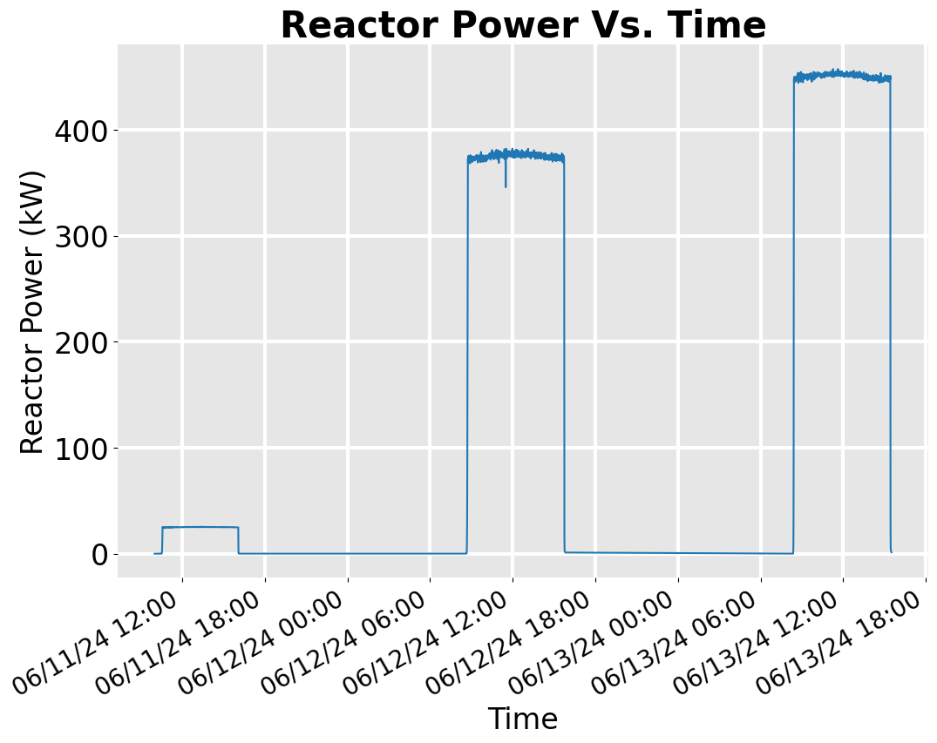
Simultaneous Irradiation Profiles
DWF Irradiation
AIF Irradiation

Slide 9
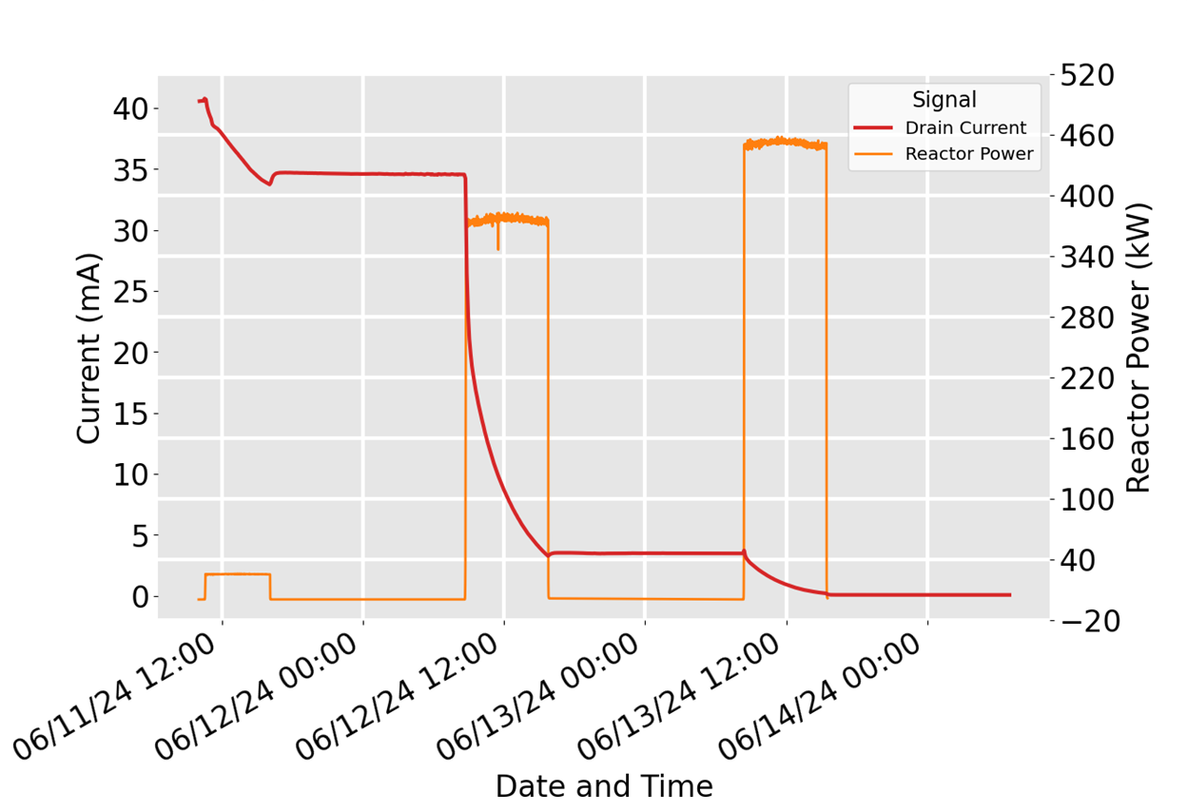
June 2024 Irradiation AIF Saturation Current Example
Variation In Saturation Current of O1_M02 (OSU GaN HEMT)
D-mode device

Slide 10
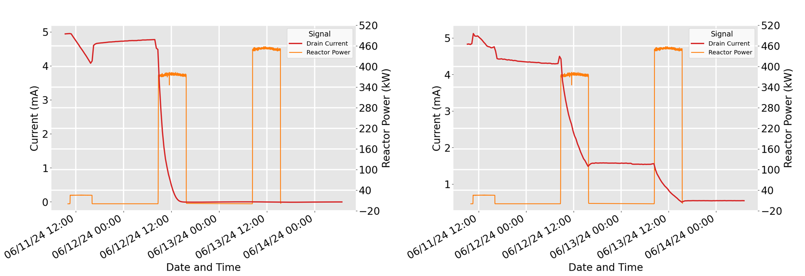
June 2024 Irradiation DWF Saturation Current Comparison
Variation In Saturation Current of N5_J (NASA JFET)
Variation In Saturation Current of O4_M03 (OSU GaN HEMT)
D-mode device
E-mode device

Slide 11
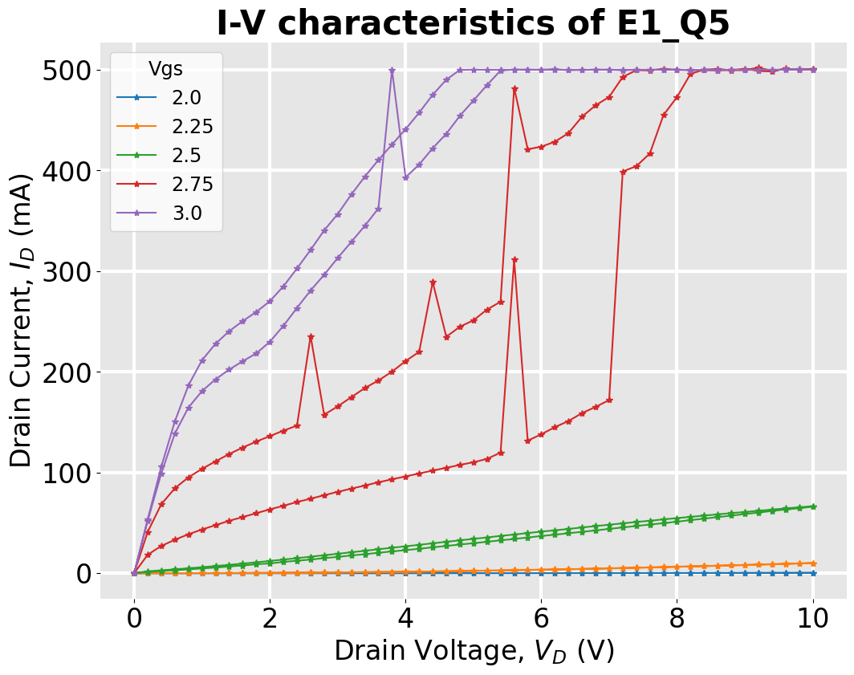
June 2024 Irradiation: EPC-Space Oscillations
E-mode device

Slide 12
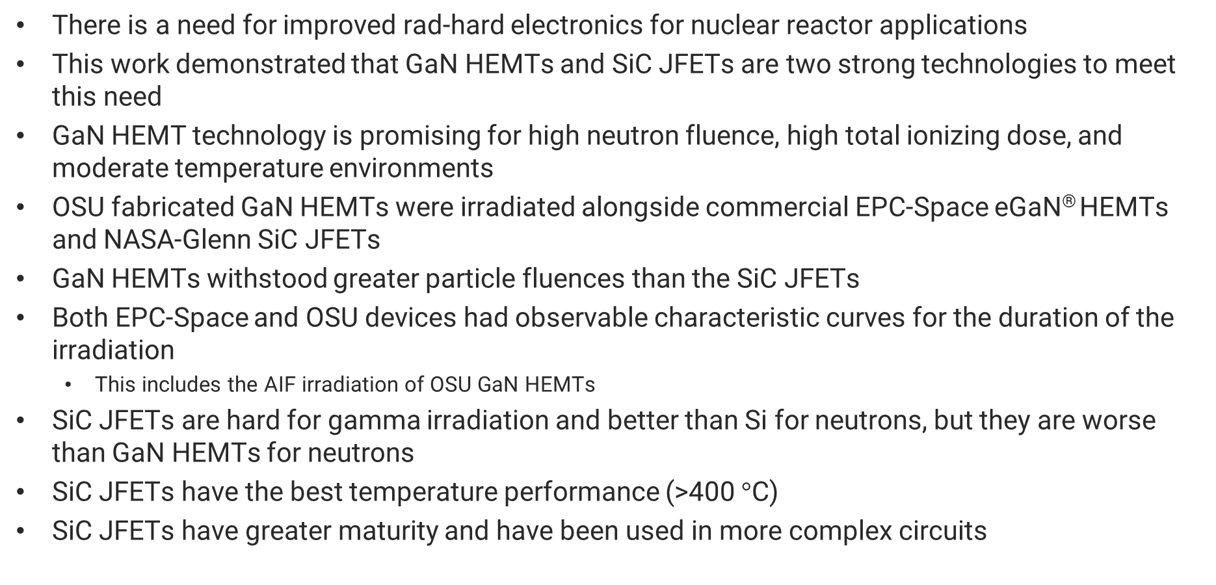
Concluding Remarks
There is a need for improved rad-hard electronics for nuclear reactor applications
This work demonstrated that GaN HEMTs and SiC JFETs are two strong technologies to meet this need
GaN HEMT technology is promising for high neutron fluence, high total ionizing dose, and moderate temperature environments
OSU fabricated GaN HEMTs were irradiated alongside commercial EPC-Space eGaN® HEMTs and NASA-Glenn SiC JFETs
GaN HEMTs withstood greater particle fluences than the SiC JFETs
Both EPC-Space and OSU devices had observable characteristic curves for the duration of the irradiation
  This includes the AIF irradiation of OSU GaN HEMTs
SiC JFETs are hard for gamma irradiation and better than Si for neutrons, but they are worse than GaN HEMTs for neutrons
SiC JFETs have the best temperature performance (>400 $°$C)
SiC JFETs have greater maturity and have been used in more complex circuits

Slide 13
Questions?
The team would like to thank NSUF, ASI, and the OSU NRL staff
F. Kyle Reed
R&D Staff, Oak Ridge National Laboratory
reedfk@ornl.gov
ORCiD: 0000-0002-2280-4574

